Slide 1
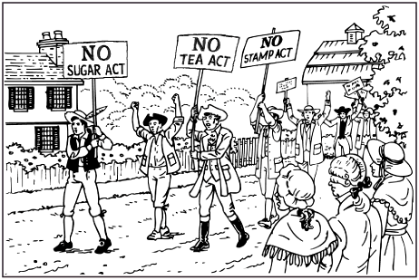
Unit 3: The Road to Revolution
Part 2: The Colonists Resist Tighter Control

Slide 2
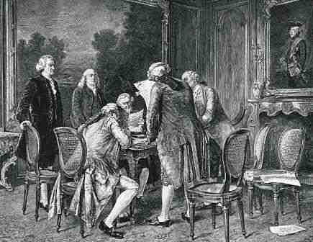
Do Now 11/28: How will the end of the French and Indian war lead to even more conflict in the colonies? (at least 2 examples)

Slide 3
Why did the American colonists begin to resist British rule?
The end of the war brought new conflicts that threatened the colonies.
Fighting with
Native
Americans
Disputes with
the British
government

Slide 4
Pontiac’s Rebellion
Beginning in 1760, American settlers began pushing west into the Ohio River Valley. This upset many Native Americans.
Pontiac, the leader of the Ottawa nation, took action to stop. He and his allies launched a bloody attack on British forts and towns. The British responded with equally brutal attacks against Native Americans.
The rebellion ended quickly after Pontiac’s warriors gave up, but thousands of settlers and Native Americans had been killed.

Slide 5
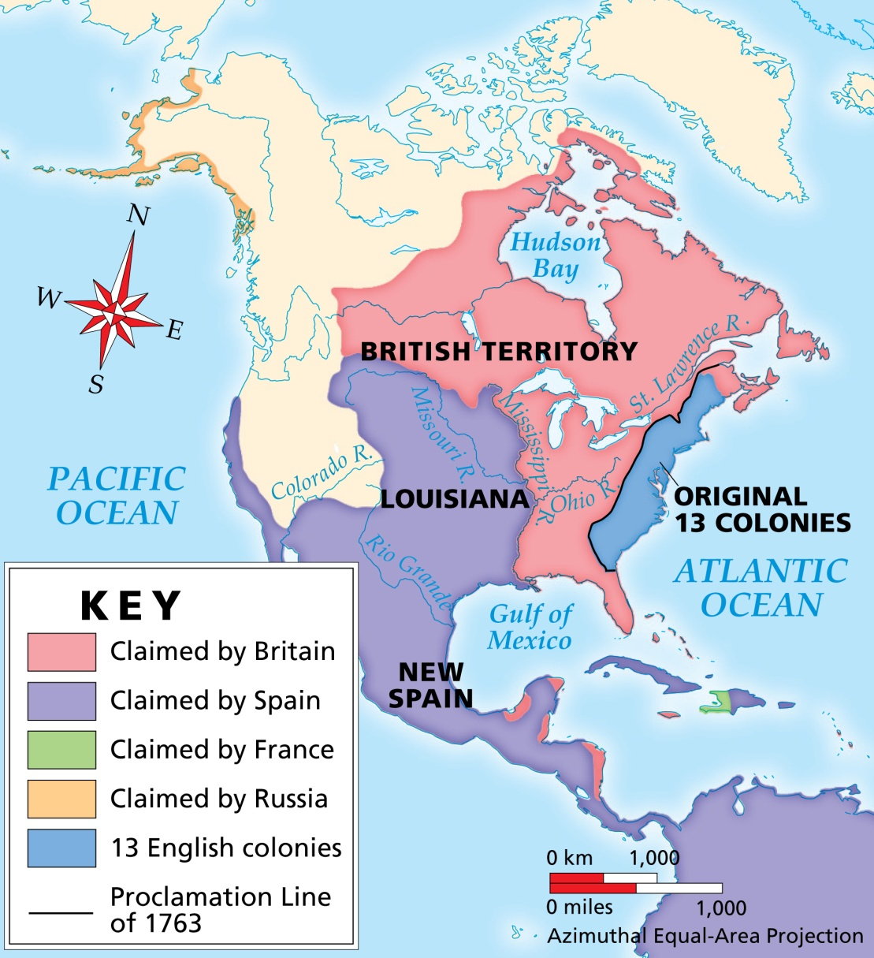
Proclamation of 1763
Hoping to avoid further wars and to protect settlers, the British issued the Proclamation of 1763.
It forbid colonists from settling west of a line drawn
Key Point
along the Appalachian Mountains. Many ignored the proclamation and continued to move west.

Slide 6
Because the war put England into debt, British leaders imposed a series of new taxes forcing the colonists to share the financial burden.
Key Point
Sugar Act | 1764
Stamp Act | 1765
Put a duty (tax) on sugar and molasses
Taxed newspapers, legal documents, playing cards and dice

Slide 7
It is estimated that the French & Indian war cost the British over
£ 70,000,000
Which today would be equivalent to
£ 8,950,000,000
OR
$ 14,315,704,000

Slide 8
British taxes suddenly outraged the colonists, and protests quickly spread throughout the colonies. Merchants organized boycotts against British goods.
Colonists had no representation in Parliament and no say on the taxes they passed. Colonists declared that ONLY their assemblies had the right to tax the colonists.
Key Point
No taxation without
representation!

Slide 9
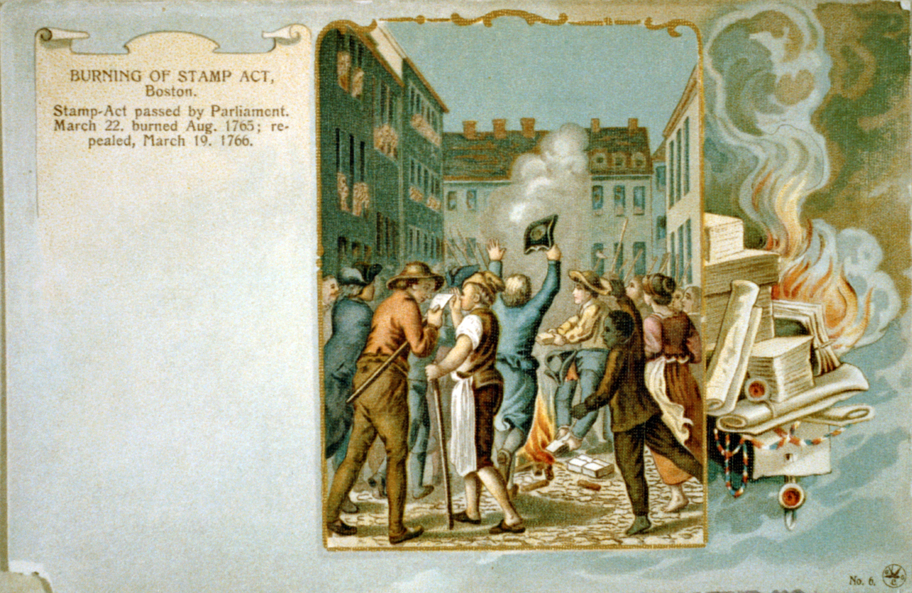
Do Now: Answer the following questions in complete sentences in your notebook.
Why was England shocked about the anger over the Stamp Act?
According to the colonists, why were the taxes imposed by England unjust?

Slide 10
Of all the new laws, the Stamp Act was the most unpopular. Delegates from nine colonies formed the Stamp Act Congress to take action.
They sent a petition to the king
and Parliament, demanding the repeal
(cancellation) of the tax law. They
succeeded, but Parliament reminded
that they were in control.
Stamp
Act
Only a year later, Parliament passed a new tax called the Townshend Acts that taxed glass, paper, paint, lead and tea.
Colonial protests continued.
Townshend
Acts, 1767

Slide 11
Sugar
Act
Stamp
Act
Taxed sugar and molasses
Taxed newspapers, legal documents
playing cards and dice; repealed
in 1766
British Taxes
Townshend
Acts
http://www.history.com/topics/american-revolution/stamp-act
Taxed glass, paper, paint, lead and tea
Key Point
Taxes were collected to help pay British debts, but colonists
protest because they have no representation in Parliament.

Slide 12
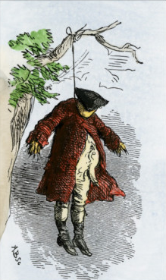
Colonists found different ways to protest taxes:
effigy – a life-sized dummy made to look like a local tax collector or government official; often hung or burned publicly
Tar and feathering
Smuggling
Nonimportation agreements – signed by merchants promising not to import taxed goods (boycott)
To fight against smuggling, tax collectors were issued writs of assistance that allowed them to search anywhere for smuggled items.
An effigy
Key Point
Anger on both sides soon led to a bloody confrontation.

Slide 13
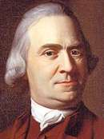
Samuel Adams became a local Boston leader in colonial protests. He helped to create new groups devoted to fight against taxes:
Committees of Correspondence: leaders from different colonies began exchanging information and ideas, helping to unite the colonists against the British.
Sons of Liberty: men devoted to the cause; commonly used physical force or violence in protests
Daughters of Liberty: women devoted to the cause; commonly helped with boycotts or creating their own products instead of buying British goods

Slide 14
Do Now: Watch the clip on the Boston Massacre.
How does the artist’s depiction of the event differ from what was believed to have actually happened?
How will this continue to fuel the fire of the colonists that will lead to revolution?
http://www.history.com/topics/american-revolution/stamp-act/videos/boston-massacre

Slide 15
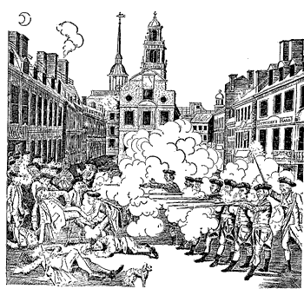
The Boston Massacre
In 1770, an angry crowd surrounded a group of soldiers in Boston.
Frightened, the soldiers fired, killing five colonists.
The soldiers were arrested and tried in a Massachusetts court – they were defended by local lawyer John Adams believing they should receive a fair trial.

Slide 16
Timeline of Events
1763
Pontiac’s War →
Proc. of 1763
1765
Stamp Act
passed
1767
Townshend
Acts passed
1764
Sugar Act
passed
1766
Stamp Act
REPEALED
1770
Boston Massacre;
Townshend Acts
REPEALED
https://www.brainpop.com/socialstudies/ushistory/causesoftheamericanrevolution/

Slide 17
Terms and People
duty – ________________________________
repeal – ______________________________
boycott – _____________________________ _____________________________________
petition – _____________________________

Slide 18
Terms and People (continued)
Nonimportation agreements – _________________ __________________________________________________
writ of assistance – ______________________________________ ____________________________________________________________
John Adams – ____________________________________________ ____________________________________________________________
Samuel Adams – _________________________________________ ____________________________________________________________

Slide 19
How much did they spend??
In 1763, the British government spent an estimated
£132,600,000.00
In today’s market, that roughly translates to
£15,200,000,000.00
or…
$24,909,760,000.00

