Slide 1
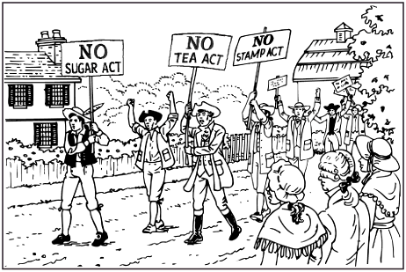
Unit 3: The Road to Revolution
Part 1: Trouble on the Frontier

Slide 2
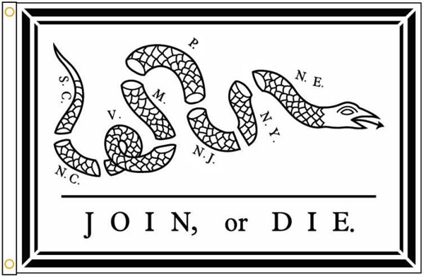
Do Now: The following image was published in a newspaper in 1754 by Benjamin Franklin. What was the message he was trying to send to his fellow colonists?

Slide 4
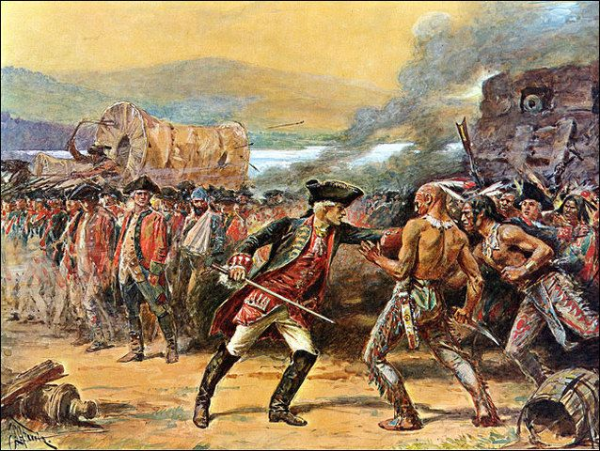
The French and Indian War
1754-1763
Fought between: France, Britain, and Native American tribes who took sides.
https://www.brainpop.com/socialstudies/ushistory/frenchandindianwar/

Slide 5
Causes of the French & Indian War
1754 - 1763
England & France compete for trade in America
England attacks France in the OHIO RIVER VALLEY
Native American allies:
Algonquin & Huron →France
Iroquois → England
WAR!
England’s goal was to win control of the Ohio River Valley
Key Point

Slide 6
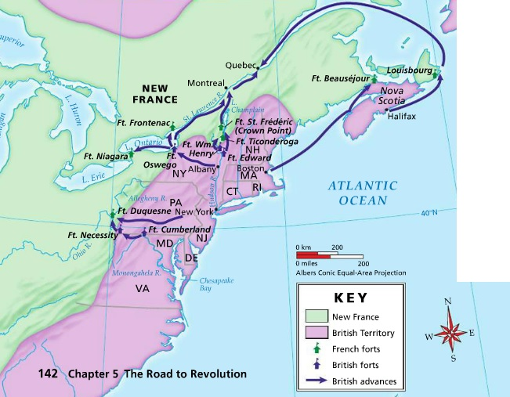
French and Indian War Battle Map

Slide 7
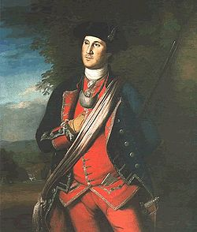
Major George Washington
A 22 year old Major George Washington began his military career during the
French & Indian War. Unfortunately, it started with a few major defeats:
Battle at Fort Necessity – surrendered to the French
Battle at Fort Duquesne (“Du Kane”) – forced to retreat after being ambushed
In 1757, England’s new Prime Minister,
William Pitt, wanted to:
focus on the war in North America
send more money, supplies & soldiers
use the best generals
Changes made under the leadership of William Pitt, England began winning the war [TURNING POINT].
Key Point

Slide 8
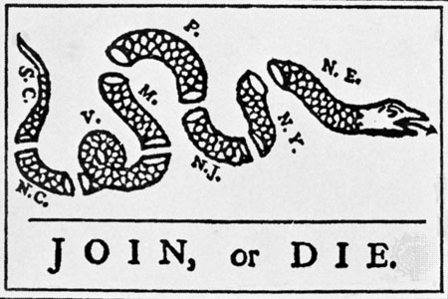
Albany Plan of Union
Meanwhile, there was a growing concern over defending the colonies. Legislatures sent representatives to Albany, NY where a meeting was held to discuss the issue.
At the meeting, Benjamin Franklin of
Pennsylvania suggested the colonies unite
under one government that would:
makes laws for the colonies
raise taxes
organize a system of defense
The plan was ultimately rejected because the colonies didn’t like the idea of giving up their individual powers to one central government for the greater good. It demonstrated a lack of unity.
Key Point

Slide 9
Battle of Quebec

Slide 10
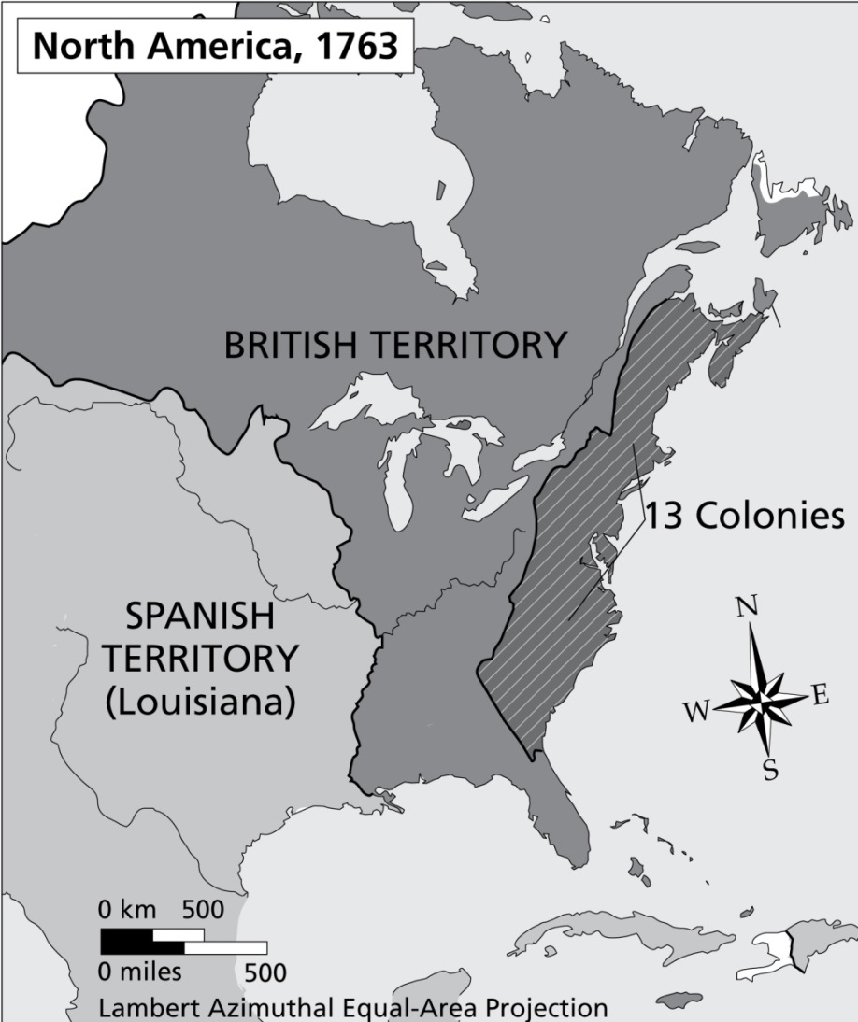
Treaty of Paris, 1763
Treaty of Paris,
1763
Under the terms of the treaty, France lost its lands in North America.
England now controlled ALL the land east of the Mississippi River, including Canada.
Key Point

Slide 11
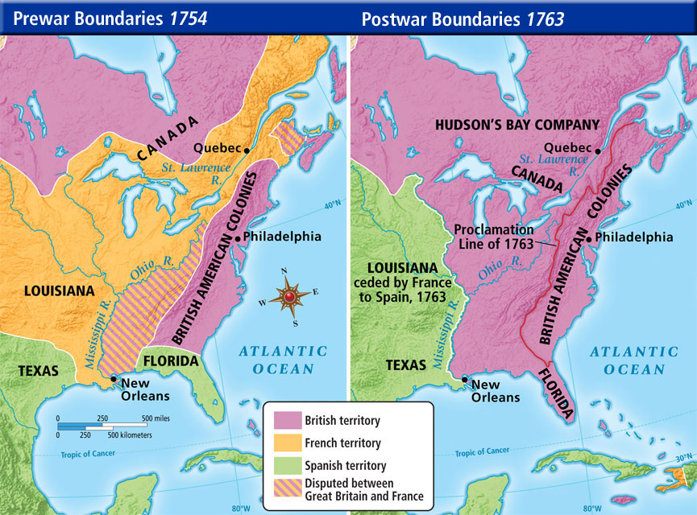

Slide 12
Main Ideas: The French & Indian War
In 1753, England began taking an interest in French lands west of the Appalachian
Mountains – the Ohio River Valley. War soon broke out after the British advised the
French to leave the Ohio River Valley. The French refused and began fortifying the region.
Native American tribes began siding with the French and English in this war. The British
and French began fighting each other all over the world – including in North America.
Over the next few years, the British tried to capture forts in the Ohio River Valley but
failed at most attempts. Prime Minister William Pitt focused all of England’s attention on
the war in North America and soon England began winning the war.
After the battle of Quebec in Canada, the British had won the war and French was forced
to sign the Treaty of Paris [1763] in which they gave up all their lands east of the
Mississippi River to England.

Slide 13
Terms and People
George Washington – ______________________________________________________________________________________
Albany Plan of Union – _________________________________________________________________________________________________________________________________
William Pitt – ______________________________________________________________________________________
Treat of Paris, 1763 – ______________________________________________________________________________________

