Slide 1
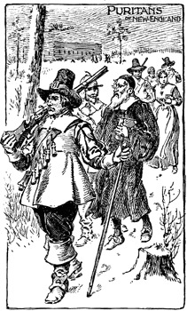
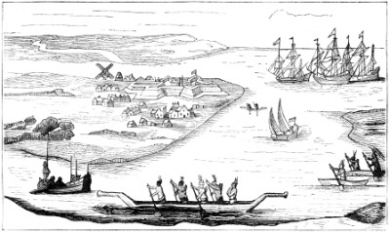
Unit 2: The 13 Colonies
Part 4: Life in the Colonies

Slide 2
How did English ideas about government and trade affect the colonies?
Colonists shared a common English bond that ________________________________________________________________________________
Such as:
______________________________
______________________________
______________________________
Key Points

Slide 3
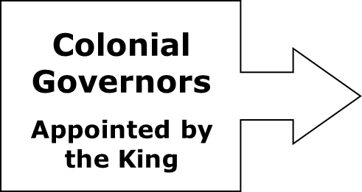
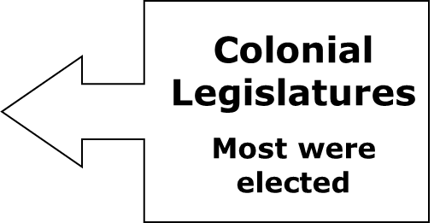
Because of the distance from England, colonies were allowed to set up their own colonial legislatures – _______________ _________________________________________________
based on England’s King and Parliament system.
UPPER HOUSE
________________________________
LOWER HOUSE
________________________________
By the 1760s, each of the 13 colonies had a similar set up. Voting rights were restricted to ________________________________________
Key Point

Slide 4
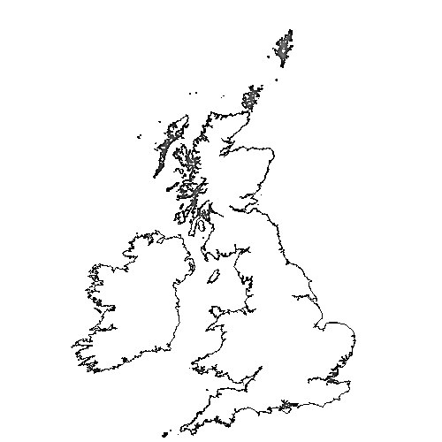
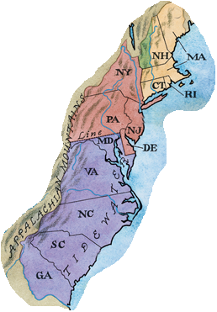
Trade
England also promoted the theory of mercantilism— __________________________________________ But some colonists began to question that theory. It soon became a problem.
Parliament passed the Navigation Acts, laws designed to __________
____________________
__________________
_________________
_________________
ENGLAND

Slide 5
How did slavery develop in the colonies and affect colonial life?
Slavery existed since Jamestown and spread to other colonies, where it became a regular part of trade and provided cheap labor especially to Southern plantations.
________________________________________________________________________________________________________________________________________________________________
Key Point

Slide 6
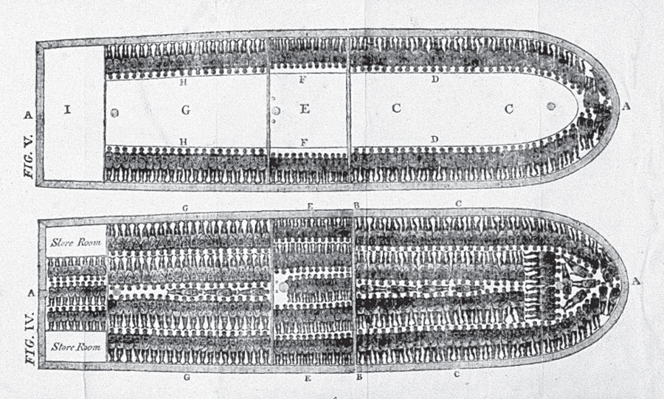
Slave Trade
Slaves were captured in Africa and sent across the Atlantic Ocean on a brutal voyage known as the _______________________.
To increase their profits, some slave-ship captains crammed the maximum number of captives on board. As a result of the foul conditions, 15 to 20 percent of enslaved Africans died before reaching the Colonies.

Slide 7
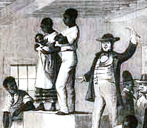
Upon reaching the Colonies, slaves were then sold at auction.
As the need for cheap labor grew, so did slavery.
________________________________________________________________________________________________________________________________________________________________
Key Point
Slaves at auction

Slide 8
Triangular Trade
First Leg
Second Leg
Third Leg
Other “illegal” triangular trade routes existed between the Colonies and other countries but many traders and merchants violated the rules because it made them wealthy.
Key Point

Slide 9
Why did slavery take root in the colonies?
__________________________________________________________________
__________________________________________________________________
__________________________________________________________________
__________________________________________________________________
Key Point

Slide 10
Slave Codes
Colonial slave codes that said enslaved people could not:
_________________________________
_________________________________
_________________________________
Also, masters who killed slaves could not be tried for murder.
Arguments over slavery continued to flare up until it ended in 1865.
Key Point

Slide 11
Terms and People
legislature - ______________________________________________________________________________________________________________________________
mercantilism - ______________________________________________________________________________________________________________________________
import – ____________________________________________________________________________________
export – ____________________________________________________________________________________

Slide 12
Terms and People (continued)
smuggle – ______________________________________________________________________
triangular trade – ______________________________________________________________________________________________________________________________
racism – ____________________________________________________________________________________
slave codes – ______________________________________________________________________

Slide 13
Pros and Cons of the Navigation Acts
Pros
Cons

