Slide 1
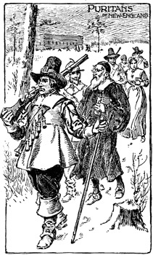
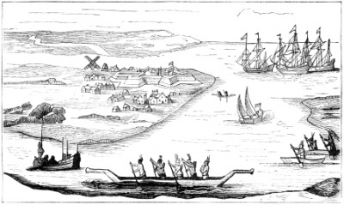
Unit 2: The 13 Colonies
Part 3: The Southern Colonies

Slide 2
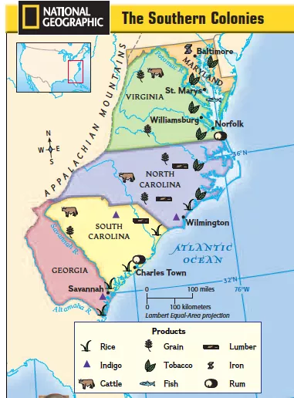
Do Now:
Look at the map of the Southern Colonies. Restate and answer each question in your notebook.
Which present-day states made up the Southern Colonies?
How do you think the climate and landforms in this region will affect how people live?
Why would people want to move here from Europe?
https://app.discoveryeducation.com/learn/videos/936b5575-e14f-429c-a661-b9550293f144?hasLocalHost=false

Slide 3
What factors influenced the development of the Southern Colonies?
Maryland
In 1632, King Charles I granted a charter for a new colony to George Calvert, an English Catholic. Calvert set up the colony of Maryland, where Catholics could live free of the persecution they suffered from in England.
When Calvert died, his son Cecil, also known as
Lord Baltimore , took over the colony.
Soon there was tension between Protestants and Catholics, and Lord Baltimore feared Catholics would lose rights.
In 1649, he convinced Maryland’s assembly to pass the Act of Toleration, which welcomed all Christians and gave adult male Christians the right to vote.
Key Point

Slide 4
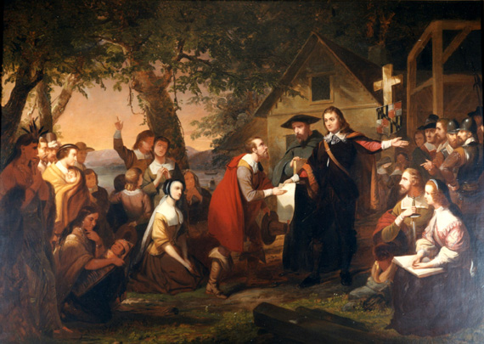
Do Now: “Founding of Maryland”,1853
Tompkins Harrison Matteson (1813-1884)
The title of the painting is “The Founding of Maryland”. However, many historians argue the artist was portraying another very important aspect of the Maryland colony. What could that be? Why is it important?

Slide 5
Virginia
Virginia’s history began with Jamestown in 1607. Since then, the colony grew around the original settlement. Tobacco quickly became the colony’s cash crop.
Violence broke out between farmers who wanted more space to plant tobacco and Native Americans trying to defend their land. When settlers received no help from Virginia’s government, they rebelled.
In 1675, Nathaniel Bacon and his followers made their way to Jamestown, attacking Indian settlements along the way.
When they arrived they burned down Jamestown in rebellion
Bacon died and the rebellion ended, but it showed what could happen when a government doesn’t protect its people.
Key Point
http://www.history.com/topics/jamestown/videos/the-value-of-tobacco

Slide 6
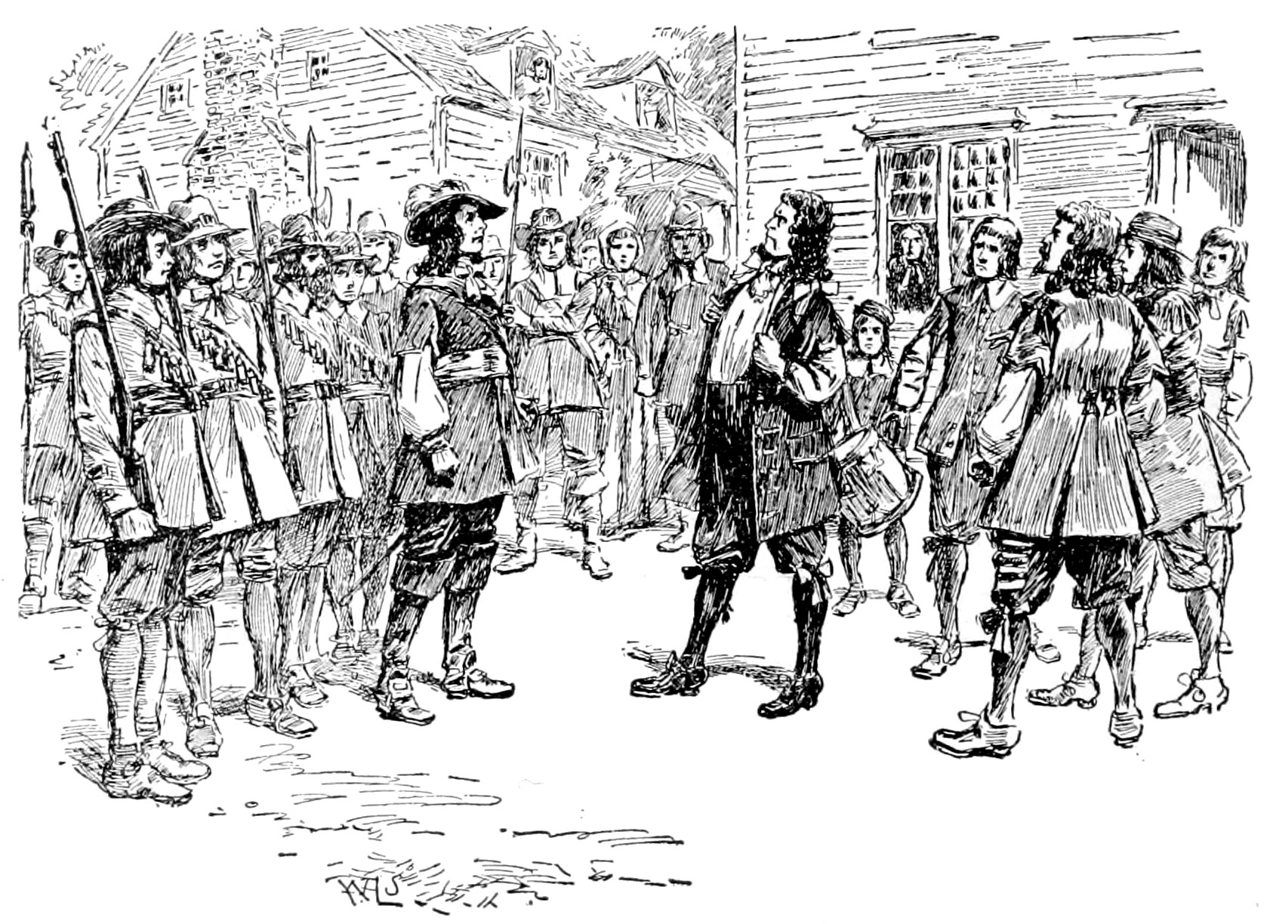
Do Now: Read the quote by Nathaniel Bacon. 1. How would you describe him as a person, based on this quote?
"[We must defend ourselves] against all Indians in generall, for that they were all Enemies."
2. Look at the image.
Who are the two figures?
What do you think is going on here?

Slide 7
The Carolinas
In 1663, King Charles II granted a charter for a new colony called Carolina to be established south of Virginia.
Northern Carolina
Southern Carolina
The northern part of Carolina had slow growth because of poor coastline (no harbors).
Poor settlers grew tobacco on small farms.
Rice & indigo grew well in the southern part of Carolina → wealthier than the north.
Large plantations imported slaves to grow cash crops → wealthier than the north.
Eventually, because of its differences, Carolina
split and established separate colonial governments.
Key Point

Slide 8
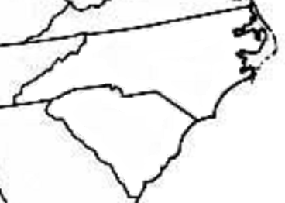
North Carolina
indigo
South
Carolina
rice
tobacco
Charleston

Slide 9
Do Now 11/1:
With a partner, use your notes or yesterday’s assignment to come up with 5 main idea statements about the Southern Colonies.

Slide 10
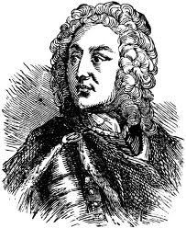
Georgia
Georgia, the last of England’s 13 colonies, was founded for two reasons:
Led by James Oglethorpe, it was a colony where debtors could get a fresh start after prison.
Act as a buffer between Spanish Florida and the other English colonies.
Key Points
Oglethorpe wanted a rigid structure for these former inmates, so rules were established:
Small farms only – no plantations
James Oglethorpe
No slavery allowed

Slide 11
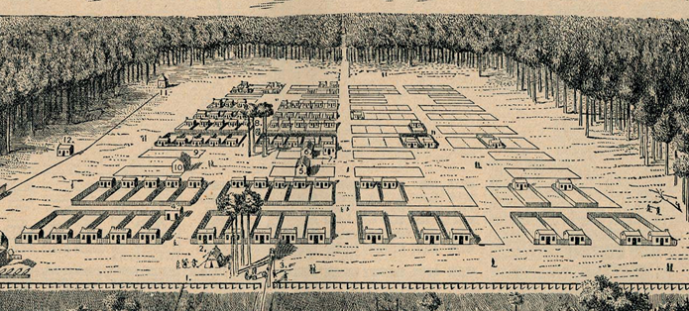
Layout of Savannah, Georgia in 1734
Equal-sized land plots
Public squares

Slide 12
Life in the Southern Colonies
Two distinct ways of life developed in the Southern Colonies.
Tidewater Region
Backcountry Region
Key Point
located on the eastern (coastal) side of each colony, dominated by large, fertile plantations
flat lowlands that include many rivers with large plantations built along them (easy access to coastal cities)
population of mostly wealthy planters with many slaves that grew rice & indigo
located on the western (mountain) side of each colony, dominated by small farms
elevated hills with more wooded lands and Indians
population of mostly poor tobacco farmers with few (if any) slaves
http://www.history.com/topics/thirteen-colonies

Slide 13
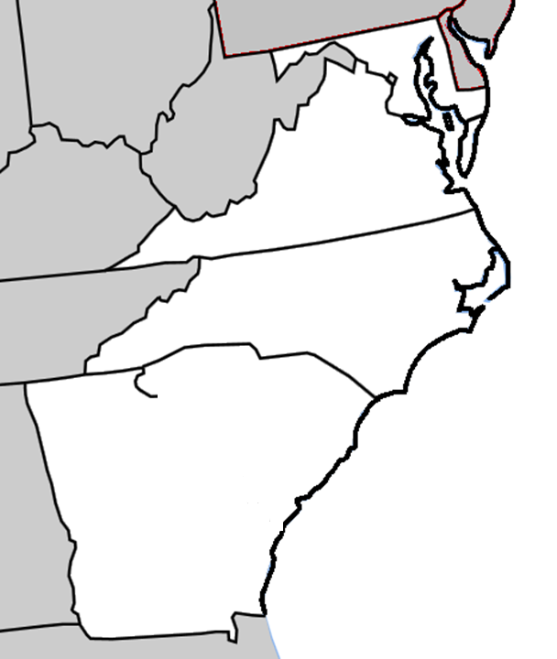
Maryland
Virginia
North Carolina
South
Carolina
Savannah River
The
Southern
Colonies
Georgia

Slide 14
Main Ideas: The Southern Colonies
Maryland was created for Catholics by the Calvert family, but the Act of Toleration in
1649 allowed for all Christina s to settle there.
A rebellion of farmers in Virginia occurred when the colonial government refused
to protect its citizens from danger.
Major cash crops of the Southern colonies were tobacco, rice and indigo.
James Oglethorpe created the colony of Georgia as a place where debtors could
begin a new life.
The Southern colonies ultimately had two distinct ways of life: the tidewater region
where large plantations, wealthy planters and slavery prospered; and the
backcountry where poorer immigrant families lived a more rugged lifestyle.

Slide 15
Terms and People
Nathaniel Bacon –
George & Cecil Calvert (Lord Baltimore) –
Act of Toleration –
James Oglethorpe –
indigo –
debtor –
plantation –

