Slide 1
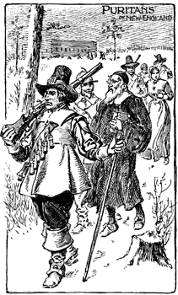
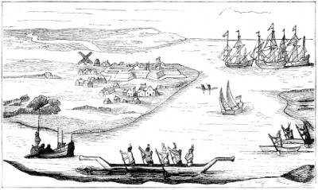
Unit 2: The 13 Colonies
Part 3: The Southern Colonies

Slide 2
What factors influenced the development of the Southern Colonies?
Maryland
In 1632, ______________ granted a charter for a new colony to ______________, an English Catholic. Calvert set up the colony of Maryland, where Catholics could live free of ______________ __________________________________________.
When Calvert died, his son _____________, also known as
___________________________, took over the colony.
Soon there was tension between Protestants and Catholics, and Lord Baltimore ___________________________________.
In 1649, he convinced Maryland’s assembly to pass the Act of Toleration, ______________________
_________________________________________
_________________________________________
Key Point

Slide 3
Virginia
Virginia’s history began with Jamestown in 1607. Since then, the colony grew around the original settlement. ______________ quickly became the colony’s _________________.
Violence broke out between farmers who wanted more space to plant tobacco and Native Americans trying to defend their land. When settlers received no help from Virginia’s government, they rebelled.
In 1675, _________________ and his followers made their way to _________________, attacking Indian settlements along the way.
When they arrived they __________________________________.
Bacon died and the rebellion ended, _______
____________________________________________________________________________________________________________
Key Point

Slide 4
The Carolinas
In 1663, King Charles II granted a charter for a new colony called Carolina to be established south of Virginia.
Northern Carolina
Southern Carolina
Eventually, because of its differences, Carolina
split and established separate colonial governments.
Key Point

Slide 5
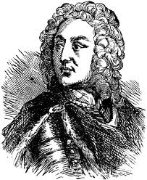
Georgia
Georgia, the last of England’s 13 colonies, was founded for two reasons:
Led by _________________, it was a colony where _________________ could get a fresh start after prison.
Act as a ______________between Spanish Florida and the other English colonies.
Key Points
Oglethorpe wanted a rigid structure for these former inmates, so rules were established:
_________________________________
James Oglethorpe
_________________________________

Slide 6
Main Ideas: The Southern Colonies
Maryland was created for Catholics by the Calvert family, but the Act of Toleration in
1649 allowed for all Christians to settle there.
A rebellion of farmers in Virginia occurred when the colonial government refused
to protect its citizens from danger.
Major cash crops of the Southern colonies were tobacco, rice and indigo.
James Oglethorpe created the colony of Georgia as a place where debtors could
begin a new life.
The Southern colonies ultimately had two distinct ways of life: the tidewater region
where large plantations, wealthy planters and slavery prospered; and the
backcountry where poorer immigrant families lived a more rugged lifestyle.

Slide 7
Terms and People
Nathaniel Bacon –
George & Cecil Calvert (Lord Baltimore) –
Act of Toleration –
James Oglethorpe –
indigo –
debtor –
plantation –

Slide 9
Life in the Southern Colonies
Two distinct ways of life developed in the Southern Colonies.
Tidewater Region
Backcountry Region
Key Point

Slide 10
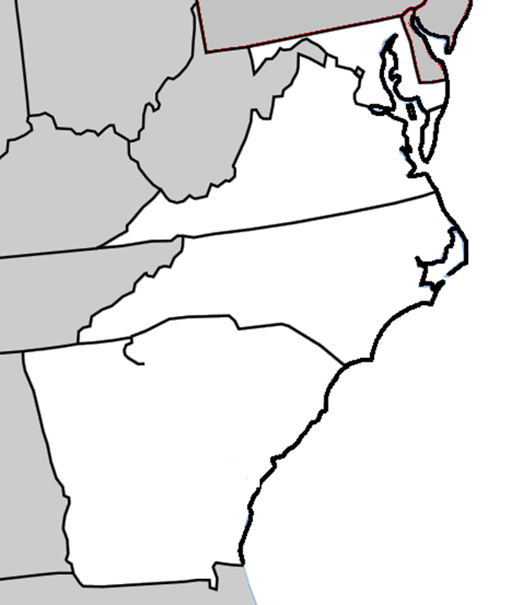
Maryland
Virginia
North Carolina
South
Carolina
Savannah River
The
Southern
Colonies
Georgia

