Slide 1
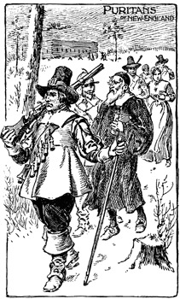
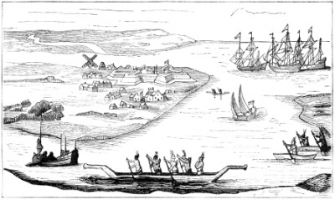
Unit 2: The 13 Colonies
Part 2: The Middle Colonies

Slide 2
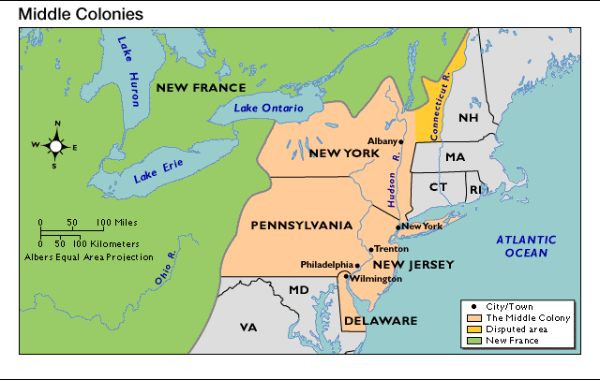
Do Now: Look at the map and think about the location of the Middle Colonies and what we’ve already learned about them.
What do you think life will be like for the average colonist?

Slide 3
How did the diverse Middle Colonies develop and thrive?
Like New England, colonists settled in the Middle Colonies for _________________ or to profit from _______________.
religious freedom
trade
Factors such as fertile soil meant better _____________. Also, ________________________ and ____________________ promoted people to move to the Middle Colonies.
farming
manufactured goods
social equality

Slide 4
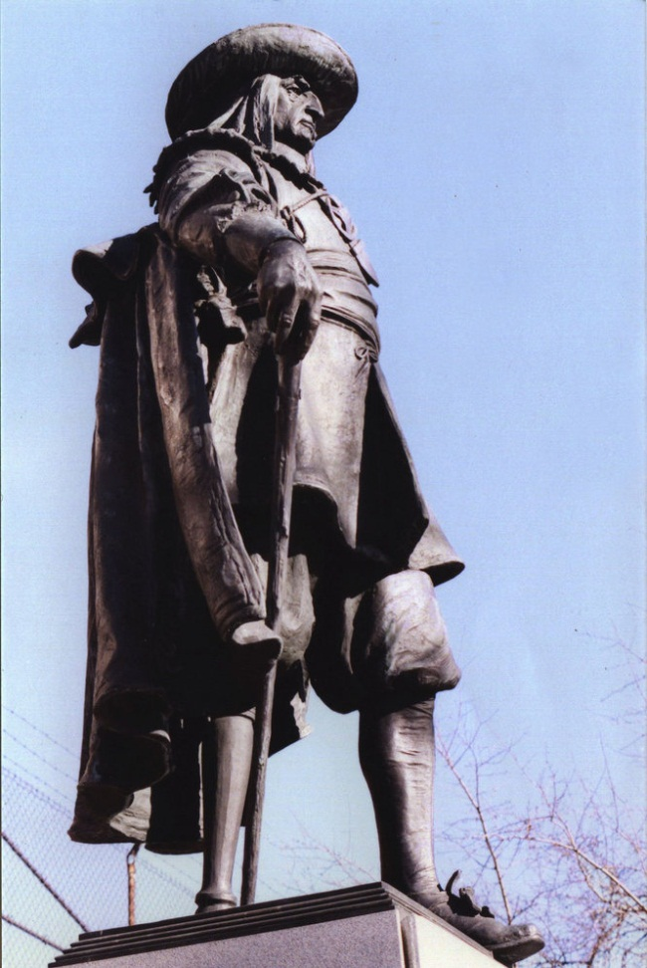
New York began as the Dutch colony of New Netherland, discovered by Henry Hudson. According to legend, the island of Manhattan was later purchased by Peter Minuit for $24 worth of goods.
The colony’s biggest settlement was _______________which had a very diverse population. The colony was tolerant of other religions and led by__________________. He was a harsh leader and not well liked.
New Amsterdam
Peter Stuyvesant
Geographically, New Netherland separated England’s northern colonies from its more southern colonies.
Key Point

Slide 5
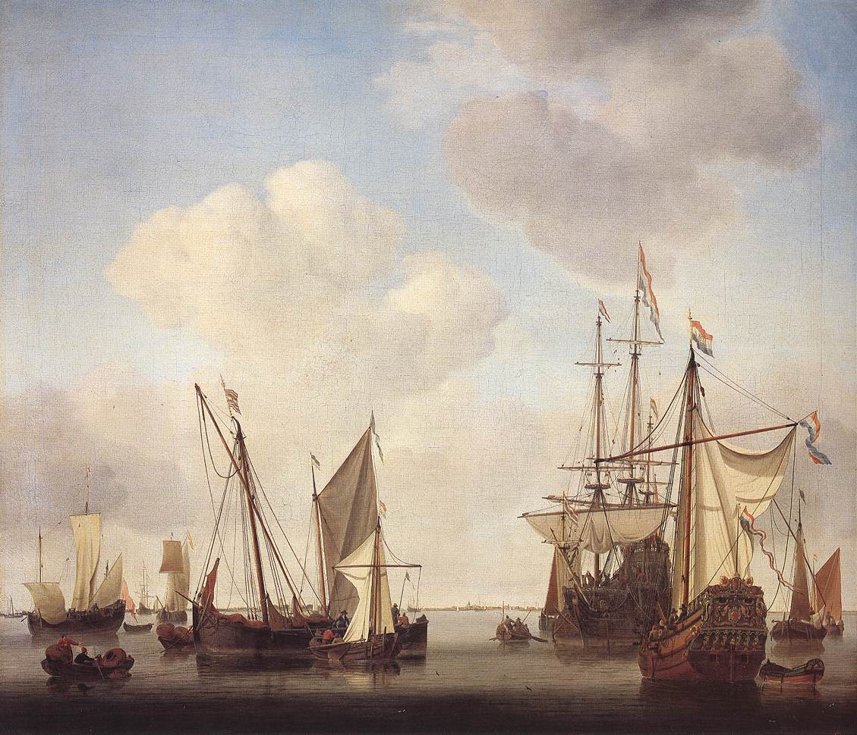
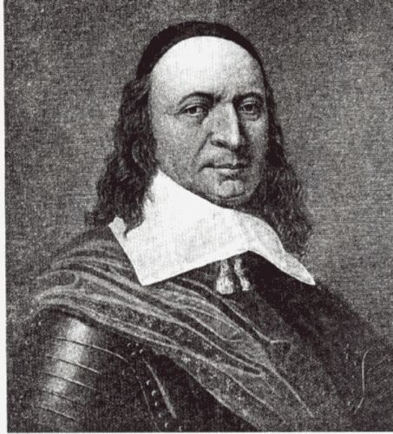
Problems in New Netherland
Farmers did not want to work for patroons, charging whatever they wanted for rent.
In 1664, England and the Netherlands fought in a war over trade in Europe and in August English warships entered New Amsterdam’s harbor.
The governor of New Netherland, Peter Stuyvesant, swore to defend his colony.

Slide 6
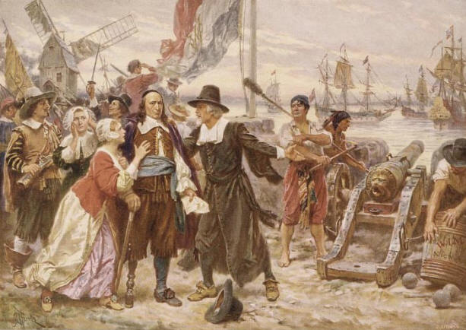
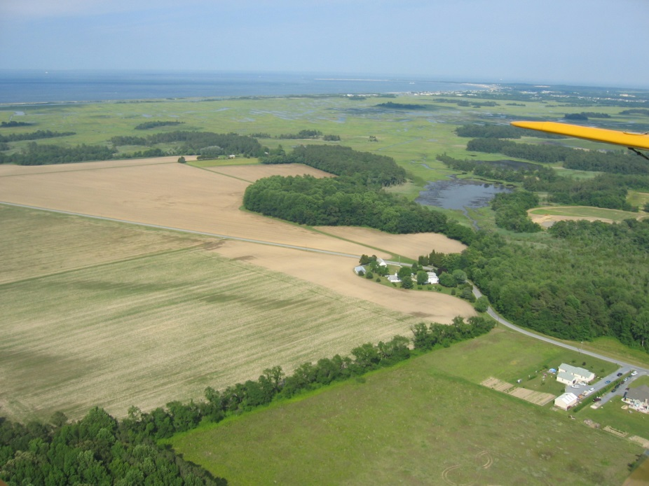
New Netherland
The Dutch set up a colony of New Netherlands along the Hudson River. The colonists traveled with the Indians and built the settlement of New Amsterdam.
To encourage farming, Dutch officials granted huge estates to a few rich families. Owners of these huge lands or manors were called patroons. In return for the grant, each patroon promised to settle 50 European families on the land.

Slide 7
England Takes New Netherland
England
Holland
By the 1660s, England and Holland were rivals. In 1664, England invaded the city of New Amsterdam. Stuyvesant tried to defend it but the people refused to fight along side him. England took the Dutch colony without a shot fired.
New York
It was renamed New York after the king’s brother, and it became a royal colony.
New Netherland

Slide 8
Do Now: Tell what you think is going on in this image.

Slide 9
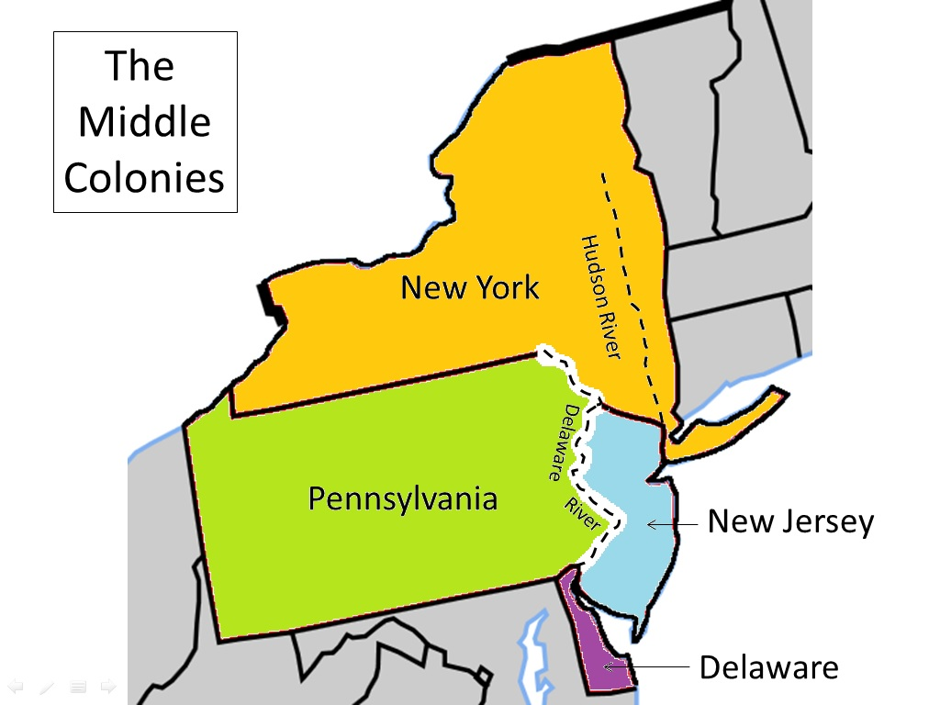

Slide 10
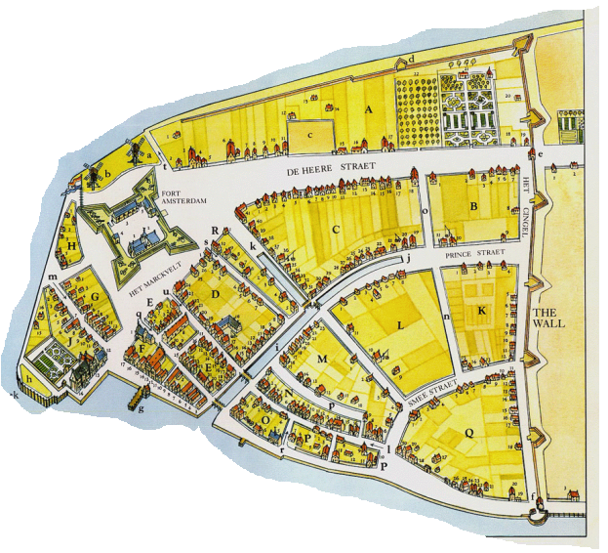
New Amsterdam
de Brede Weg
Broadway
batterij
The battery
(fortress)
Battery Park
Walstraat
Wall Street
bouwerij
The Bowery
(small farms)
Notes:
10

Slide 11
Other Examples of Dutch Influence on Place Names
Breukelen
Kats Kill
(Brooklyn)
(The Catskills)
Jonas Bronck
Konijneneiland
(The Bronx)
(Coney Island)
Haarlem
't Lange Eiland
(Harlem)
(Long Island)
jonker
Vlissingen
(Yonkers)
(Flushing)
Noord Rivier
(North River – the Hudson)

Slide 12
New York Creates New Jersey
New York
In 1665, because of it’s size,
part of southern New York split off and formed a new colony, New Jersey.
At first, New Jersey was a proprietary colony, and controlled by many people but in 1702, it received a new charter as a royal colony.
New Jersey
proprietary colony –is when the King gives land to one or more people in return for yearly payments.
https://app.discoveryeducation.com/learn/videos/98DFEEED-5F30-4A3E-8B89-ED3089B92A1F?hasLocalHost=false

Slide 13
William Penn & the Quakers
The Quakers emerged as a new religious group in England. They were persecuted for their beliefs. The Quakers believed:
in non-violence – they were against serving in wars
War
Key Points
all people are equal in God’s eyes; therefore, women are equal to men in spiritual matters, slavery is wrong and Native Americans also deserve fair treatment
Slavery
https://app.discoveryeducation.com/learn/videos/0E992BA8-0600-46F0-B7EB-A8FCC9EC4E21?hasLocalHost=false
https://app.discoveryeducation.com/learn/videos/33126C79-6559-4262-B101-E613F5F3EE9F?hasLocalHost=false

Slide 14
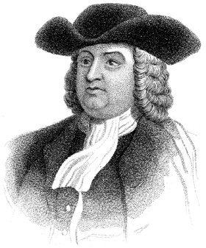
Pennsylvania
Quaker leader William Penn wanted to find a place where Quakers could live free of persecution.
He got a charter from the king for a new colony in North America. Pennsylvania was established in 1682 and its capital was named Philadelphia, the “City of Brotherly Love”.
Penn’s colony was built on good moral Quaker beliefs and was considered his “holy experiment”.

Slide 15
Penn Meeting with the Native Americans, 1682
What do you think is going on in this painting?
Does it look peaceful or tense? How do you know?

Slide 16
Pennsylvania Creates Delaware
Penn’s charter for Pennsylvania included an area far south of ______________ known as the ____________ ____________. Because of the distance, Penn gave them their own representative assembly.
Pennsylvania
Philadelphia
Lower
Counties
In 1704, Delaware became a separate royal colony.
Delaware
_____________
**Remember: Royal Colony - a colony under the direct control of the English crown. (Religious freedom and rights of assembly were protected by colony’s charter.)

Slide 17
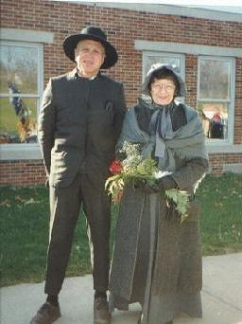
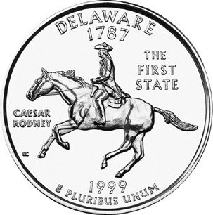
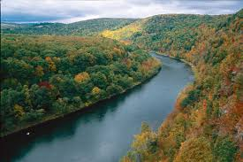
Delaware - Originally included in Pennsylvania
Known as Pennsylvania’s Lower Counties
Settlers in the lower countries did not want to send delegates to a far away assembly in Philadelphia.
In 1701 William Penn allowed the people in the lower countries to elect their own assembly. Later the lower countries broke away to form the colony of Delaware.
https://app.discoveryeducation.com/learn/videos/4b864918-4055-4cc7-b03e-35e64e414388

Slide 18
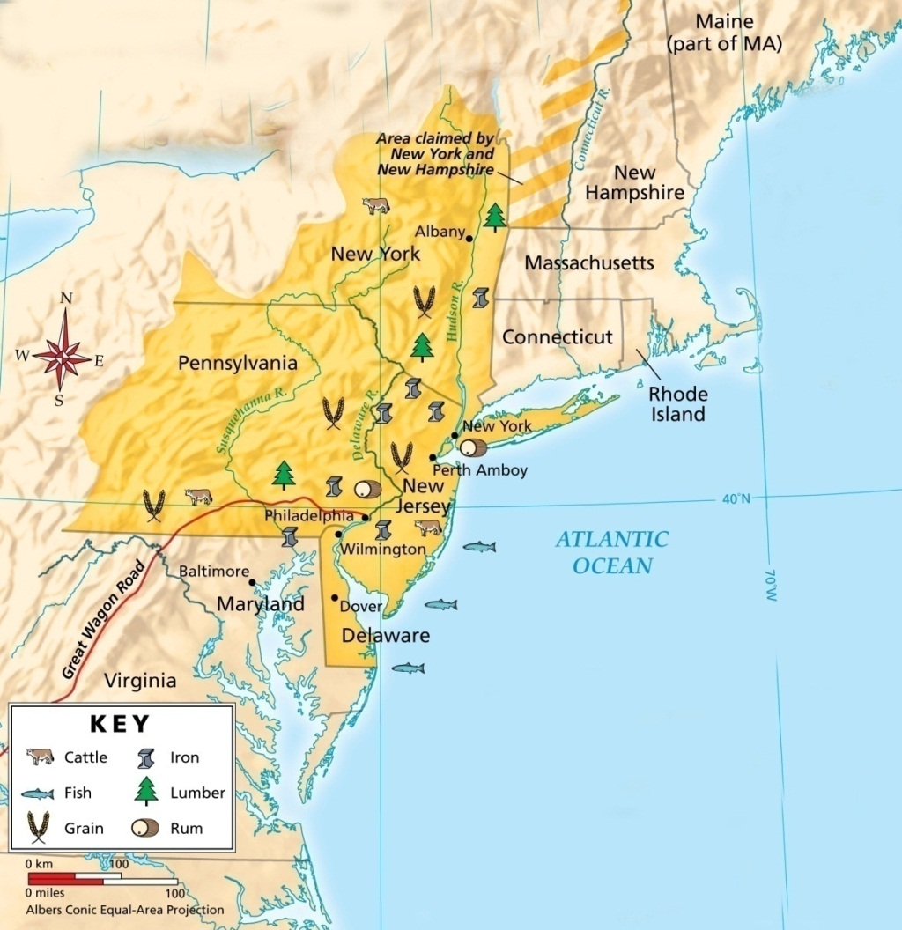
Life in the Middle Colonies
Fertile river valleys like the Hudson and Delaware Rivers offered excellent farming opportunities.
Wheat and grain farms were productive, and the Middle Colonies became America’s breadbasket.
Key Point
Notes:
18

Slide 19
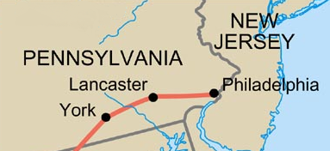
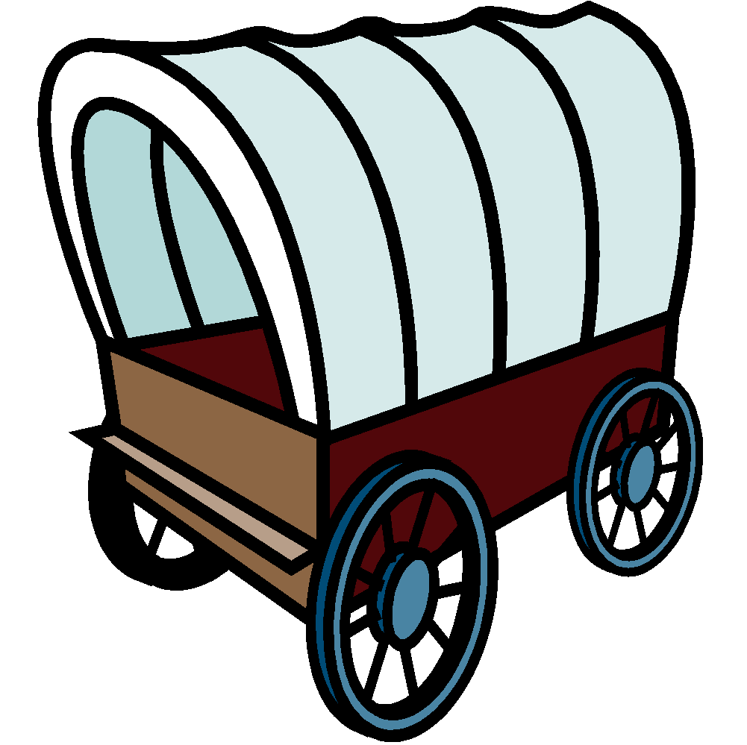
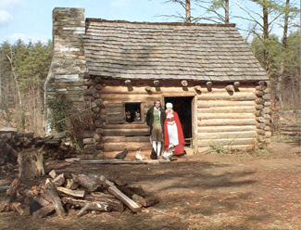
Great Wagon Road
New immigrants arrived in Philadelphia but couldn’t afford to live there so they moved west to build communities in an area known as the backcountry. As more settlers moved west towards the mountains, the Great Wagon Road developed and stretched into the Southern colonies.
Notes:
19

Slide 20
Life in the Middle Colonies
Geography
People
Work
The Hudson and Delaware rivers are important waterways in the region.
The soil is fertile and good for crops like wheat, grain, fruits, and vegetables. Climate is mild, all 4 seasons
diverse European population (German, Irish, Dutch, English, Scottish, Swedish, etc.) Religious tolerance
many immigrant groups head west towards the mountains, an area called the backcountry (Great Wagon Road)
skilled craftsmen helped produce many manufactured goods
wheat and grains = cash crops
known as the “Breadbasket colonies”

Slide 21
Terms and People
proprietary colony – a colony created by a grant of land from a monarch to an individual or family
royal colony – a colony controlled directly by the English king
Peter Minuit – bough Manhattan island for the Dutch
Peter Stuyvesant – governor of the Dutch colony of New Netherland
William Penn – a Quaker leader who established the Pennsylvania colony and its capital, Philadelphia

Slide 22
Terms and People (continued)
diverse – mixed ethnicity; many types of ethnic groups
manufactured goods – goods made by hand like guns, furniture, iron, flour, etc.
backcountry – a western frontier region extending through several colonies, from Pennsylvania to Georgia
cash crop - crops native to a specific area and grown for profit

