Slide 1
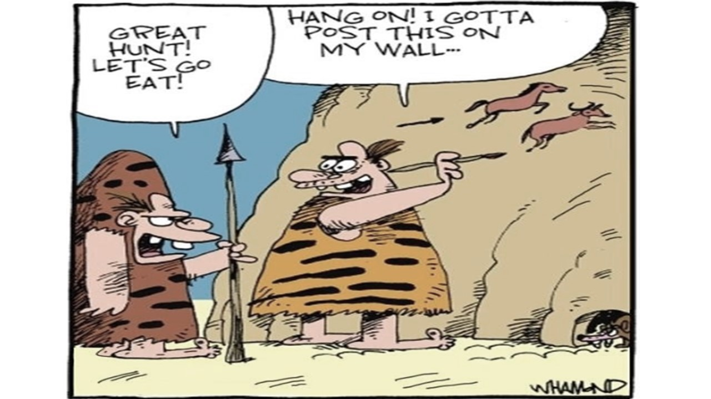
Unit 1: Early Humans and Societies

Slide 2
Do Now: Define prehistory.
The period of time before humans developed written language.
Other vocabulary:
Hominid: An early ancestor of humans
Ancestor: a relative who lived in the past (older than a grandparent).

Slide 3
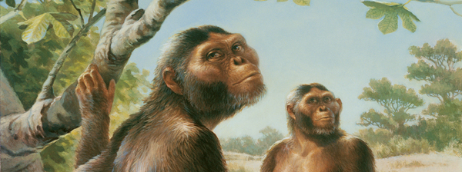
Lucy
“Lucy in the Sky with Diamonds”
3.8 million years old!
One of the earliest ancestors of humans.

Slide 4
Look at the picture. What do you notice?
They’re using tools! This is “Handyman” They used tools to make life easier. This is considered “technology.”

Slide 5
Look at the picture. What do you notice?
Homo erectus stood upright and used fire for warmth and cooking.

Slide 6
The Last Hominid-Homo Sapiens How do you know the person in the image in a Homo Sapien?
They’re using language!
https://www.brainpop.com/science/ecologyandbehavior/humanevolution/

Slide 7
Hominid Chart
Scientific Name | Nickname | Ability | Symbol
Australopithecus | Lucy | Biped Opposable thumbs
Homo Habilis | Handy Man | Used tools
Homo Erectus | Upright Man | Stood up straight Fire
Homo Sapiens | Wise Man | Written/spoken language

Slide 8
Hunter Gatherer Societies
Define societies:
Define hunter gatherers:

Slide 9
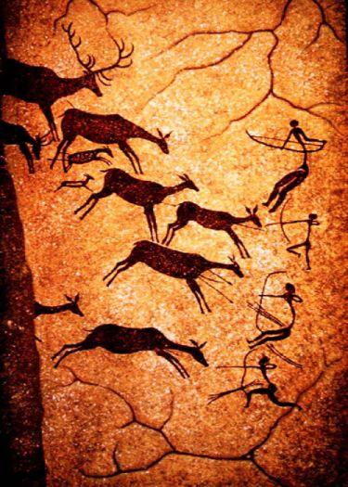
Do Now 10/8:
Look at this piece of cave art and write down three facts about the group who made it.

Slide 10
Cave Art
Scientist aren’t sure why they made these paintings.
They are the best artifacts archaeologists have to explain life in Stone Age cultures. (No written language!)
The drew what they knew.

Slide 11
“Cave of the Hands”-Argentina.

Slide 12
Lascaux Cave, France. These drawings are over 17,000 years old.

Slide 13
What can cave art tell archaeologists?

Slide 14
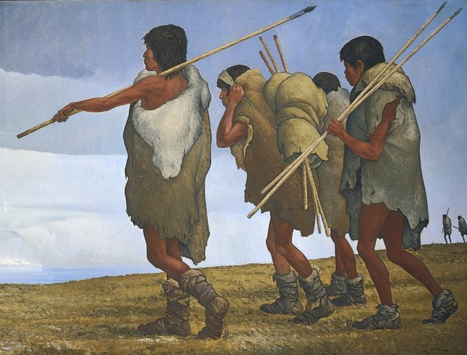
Do Now: 10/18
How do scientists believe the first
humans migrated to the Americas?
As humans migrated around the world, what was a challenge they faced?

Slide 15
Early Human Migration:

Slide 16
Why did humans move or migrate?
Plant life in area gets used up
Animals move out
Reasons to move/migrate
Population increase-too much competition
Weather and seasonal change

Slide 17
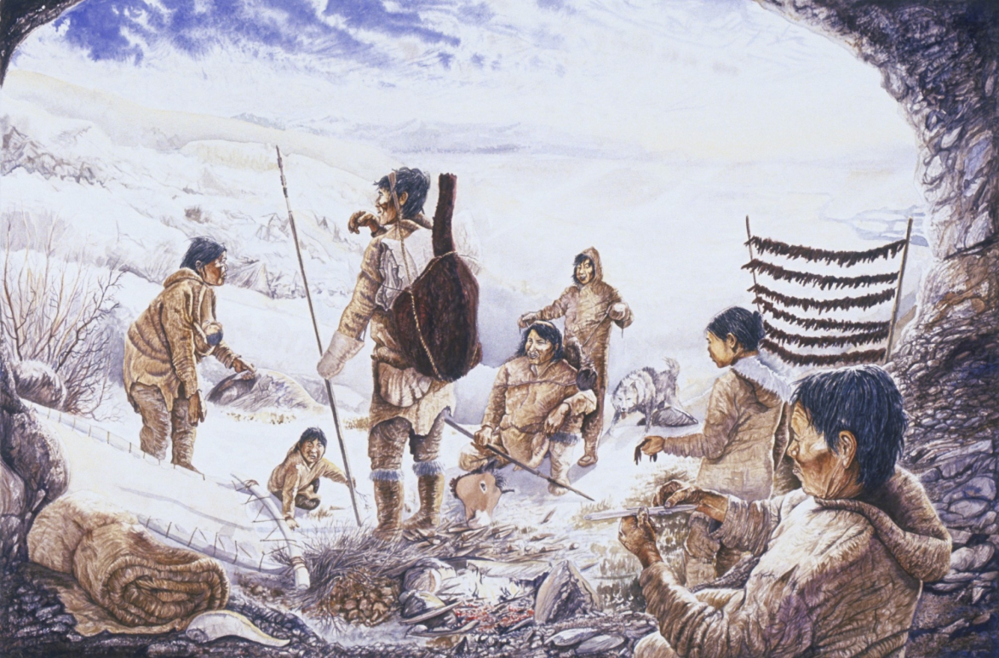
People Move out of Africa:
Humans migrated, or moved, mostly due to climate changes
Much of earth was frozen, water levels were lower
A narrow strip of land connected Asia and North America- “Beringia”
http://www.history.com/topics/native-american-history/native-american-cultures/videos/the-first-americans

Slide 18
Paleolithic Era (Old Stone Age) vs. Neolithic Era (New Stone Age)
Paleolithic Era | Neolithic Era
Began around 3.5 million years ago | Began around 10,000 years ago
Little progress made | Great progress made
Relied on pebble or rough stone tools | Learned to polish stones to make tools like saws. Learned to shape and sharpen stone like flint and obsidian
People were nomadic hunter-gatherers | People LEARNED TO FARM!!!! Domestication: controlling how and where plants are grown so they are useful to humans. This allows humans to live in a permanent settlement!

Slide 19
Neolithic Revolution
Warming trend, new wild plants begin to grow, like barley.
People settle near these plants and learn they can plants seeds to grow their own crops. (**HUGE DEAL!!!)
They learn to domesticate animals for human use. Meat, milk, wool, and to help with farming.
Domestication of plants leads to agriculture (farming)
**People now stay in one spot!!
People live in villages, have a surplus of food, and separate the work- they now have specific jobs.
Humans will then form advanced civilizations!

Slide 21
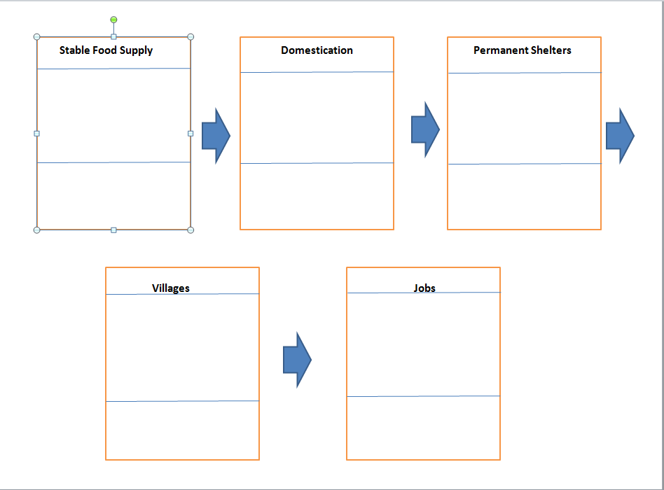

Slide 23
Early Humans Unit Vocabulary
Term | Definition | Sentence | Symbol
hominid
Paleolithic Era
Neolithic Era
migrate
domesticate

