Slide 1
Copyright © Clara Kim 2007. All rights reserved.

Slide 2
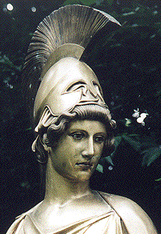
Who fought?
1. Delian League: Athens and other small city states that supported democracy
2. Peloponnesian League : Sparta and other city states that supported an oligarchy.

Slide 3
Causes
After the Persian War tension was building for years.
Athens had supreme power and others resented them.
Controlled the Delian League (map next slide)

Slide 4
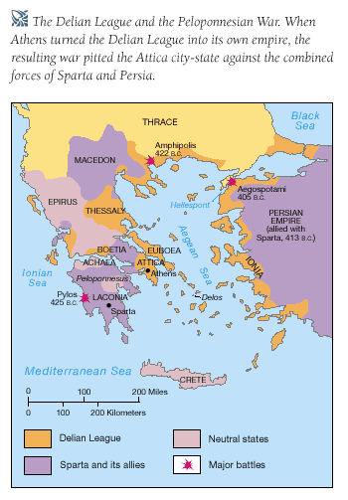

Slide 5
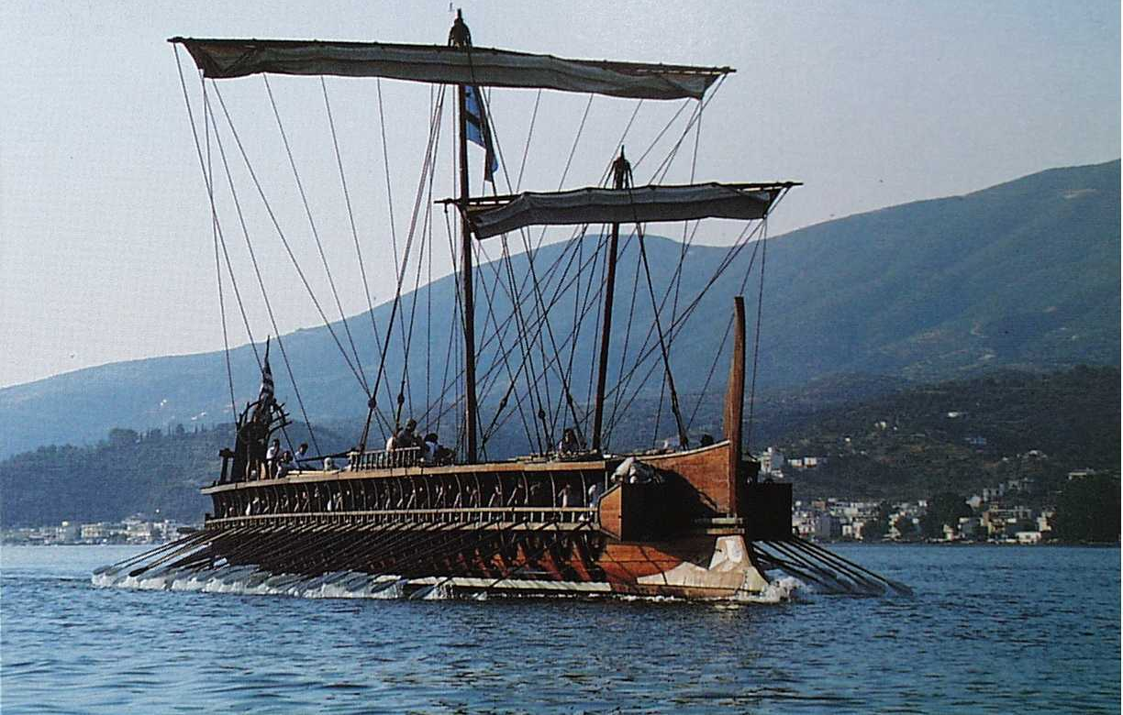
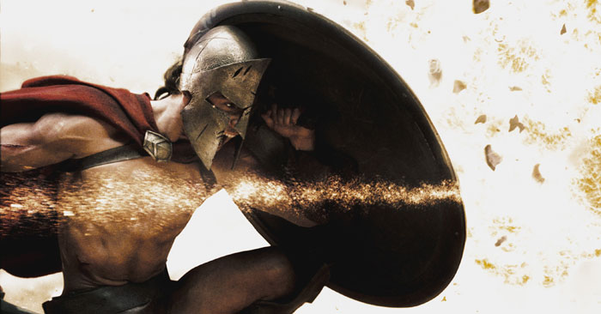
Athens vs Sparta
Athens = strongest sea power in Greece
Sparta = strongest land power in Greece

Slide 6
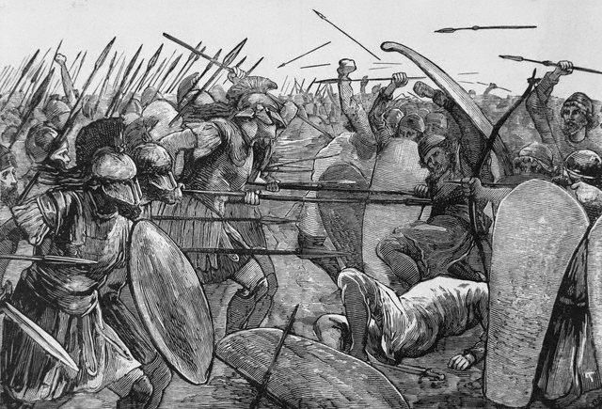
Spartans
Athens

Slide 7
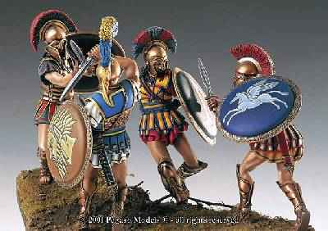
Who Won?
SPARTA!

Slide 8
How Did Sparta Win?
Sparta was located inland so it could not be attacked from the sea
Athens could be attacked by sea and land
Athens tried to move its people behind the acropolis and plague broke out = weakened Athens

Slide 9
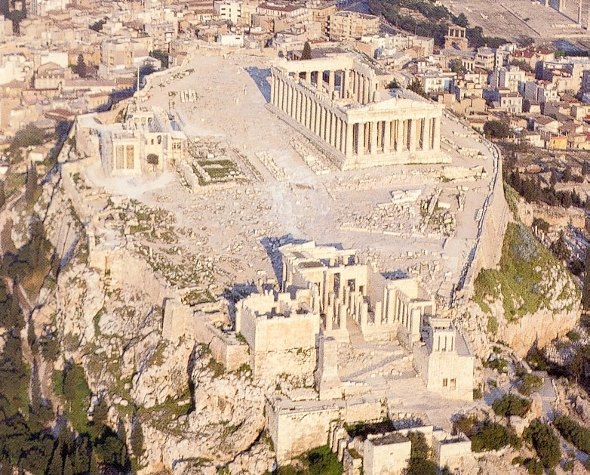
Acropolis

Slide 10
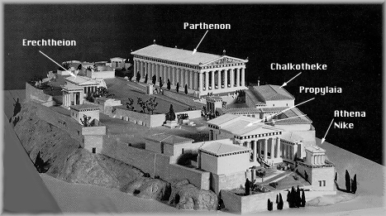
Acropolis

Slide 11
Effects of the Peloponnesian Wars
Ended the reign of Athenian greatness
Corruption replaced good citizenship
People lost faith in democracy
Sparta’s is taken over by Thebes
Macedonia becomes the next great power

Slide 12
