Slide 1
Do Now:
Write 2 a sentence description, that best describes Greece’s artistic legacy?
Name the three types of classical Greek columns?

Slide 2
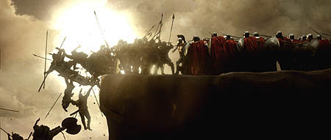
Persian Wars
490BCE- 479 BCE
Notes:
‹#›

Slide 3
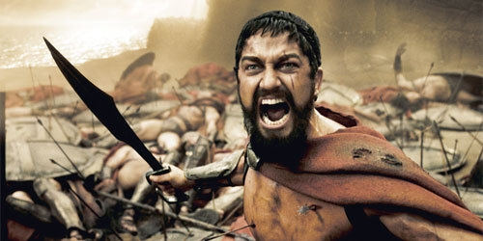
Who Fought?
The Persians Fought against the Greeks
Persia was ruled by Darius and Xerxes
Greeks- Athenians, Spartans, Ionians

Slide 4
Why Fight?
Greeks had been settling on the west coast of Asia Minor in Ionia (Persia)
Persia conquered these colonies
In 499 B.C. Greeks in these colonies revolted against Persian rule (they were used to ruling themselves—democracy)
Athens sent troops to support the revolt

Slide 5
Crushing the Revolt
Emperor Darius of Persia crushed the revolt rather quickly
He decided to punish Athens for helping the colonies
After training for a few years Darius sent troops to invade Greece
Sailed on to the Bay of Marathon

Slide 6
Major Battles
Battle of Marathon: Sparta and Athens work together
Persia- 25,000 soldiers
Greeks- 10,000 soldiers
Phalanx battle formation gave the Greeks the victory
6,400 Persians died
192 Greeks died

Slide 7
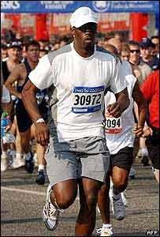
Pheidippides
Ran to Athens from Marathon = 26 miles
Told them of the victory
Died after giving the news
* This is why marathons are now 26 miles!

Slide 8
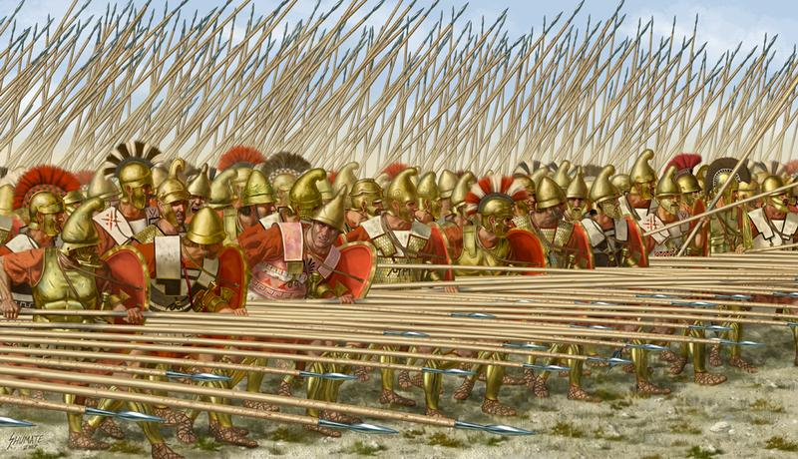
Phalanx Formation

Slide 9
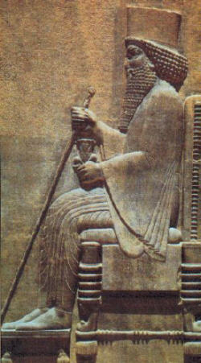
Part 2: Persian War
10 years later
Xerxes, son of Darius vowed revenge.
Brought between 100,000-300,000 troops through a narrow mountain pass

Slide 10
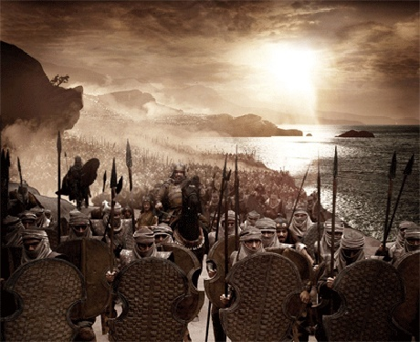

Slide 11
Battle at Thermopylae
3,300 Greeks led by the Spartans held them off at a narrow pass in Thermopylae.
A traitor told Persians of another way around
Many Greeks retreat but 300 Spartans stood strong.
They all died

Slide 12
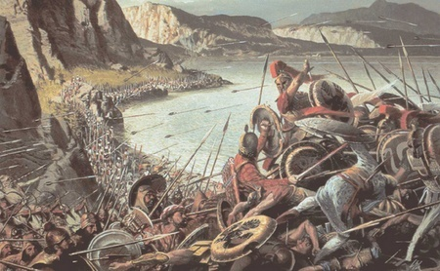

Slide 13
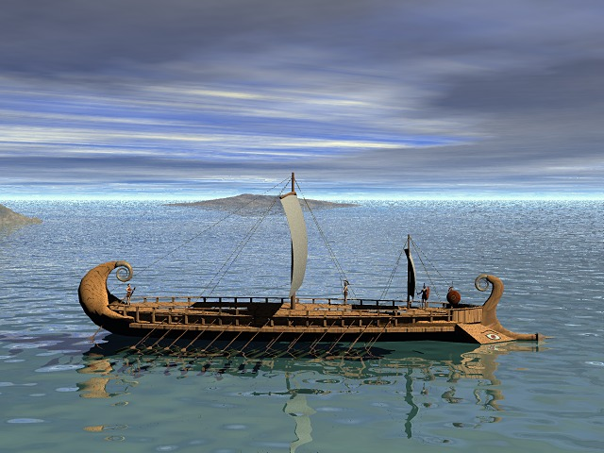
Trireme
Notes:
‹#›

Slide 14
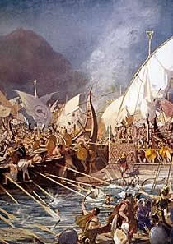
Battle at Salamis
Athens is evacuated and fought at sea.
Athenians had a powerful navy
Greeks fought with new ships called Trireme.
Triremes punched holes in Persian ships and sink a third of the ships.
Notes:
‹#›

Slide 15
Effects of the Persian Wars
Greece victory creates a sense of unity
Athens had control of what was left of Greece through leadership of the Delian League.
Delian League- an agreement that the remaining Greek city states would help each other
Notes:
‹#›

