Slide 1
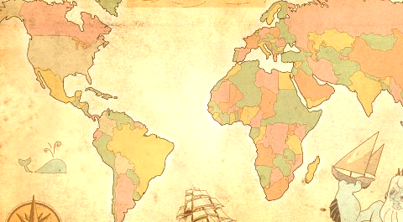
Welcome to 6th Grade Social Studies
Laura Lucid
LLucid@ryeneck.org

Slide 2
Materials Needed in Class:
Binder with 1 subject notebook inside
Homework folder
Agenda
Writing utensil
*I’ve also asked for a folder that I will be collecting for our research paper.*

Slide 3
Textbook
World History- Holt McDougal
- Online version to use at home
Should be used as a reference for homework and studying

Slide 4
“inquiry Based Learning”
Start each unit with a compelling question
For example:
Was the development of agriculture a great step forward for humans?
Was Alexander actually “great?”

Slide 5
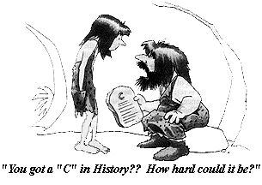
Expository and Document Based Writing
Making a claim and supporting it with evidence.
Analysis of that evidence
Using documents (maps, political cartoons, quotes, etc.) for historical inquiry

Slide 6
Topics Covered this Year:
Geography
Pre-History
Ancient Egypt and Nubia
Ancient China
Ancient India and Persia
Ancient Greece
Ancient Rome
Byzantine Empire &Ancient Arabia
Medieval Europe
The Renaissance and Exploration

Slide 7
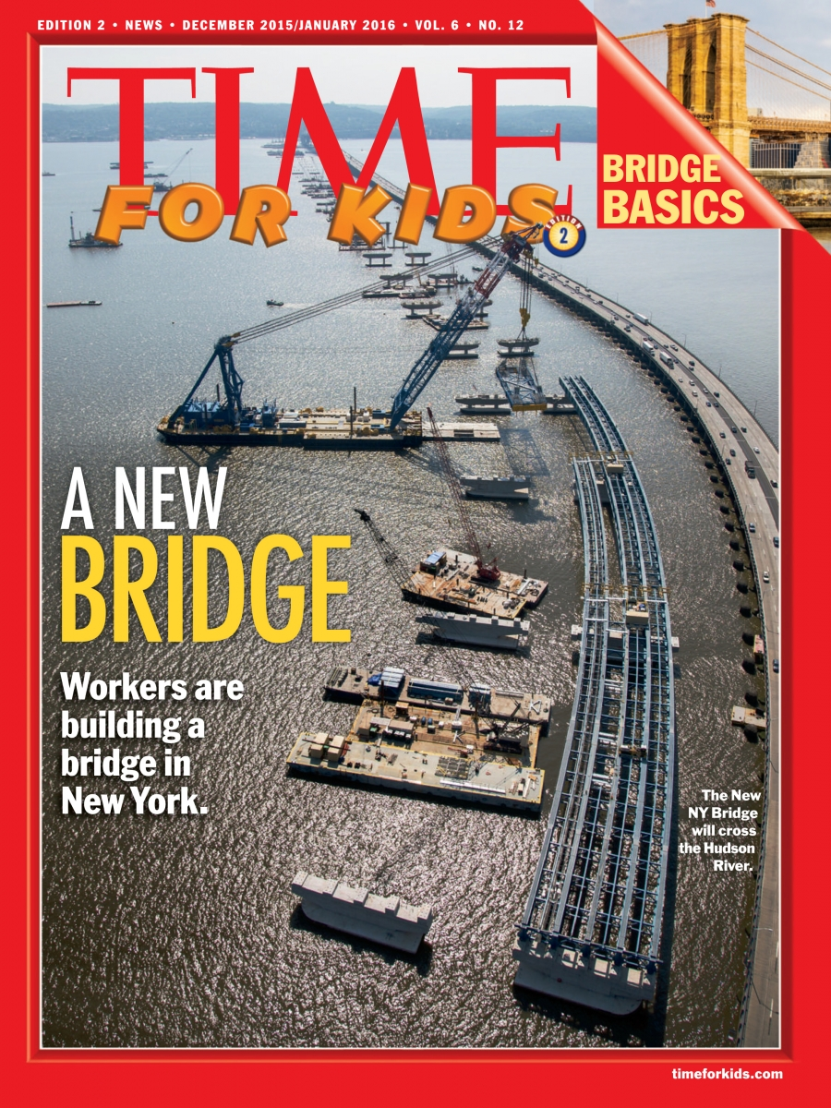
Current Events and Presidential election:
Time for Kids Magazine:
CNN Student News

Slide 8
Grades:
4 Report Card grades
4 Progress Reports
Check Parent Portal on E School regularly
10%-Student performance
35%-Quizzes
45%-Tests, projects, essays
10%-Homework

Slide 9
Teacher Webpage
URL- http://LUCIDSS6.WEEBLY.COM

Slide 10
How can you help your child be successful this year?
Organization is key:
help them go through papers and clean things out when necessary.
Help them make sure they have what they need in their binder before they leave for school.
Have them teach you:
If they are able to explain the content to you, then they truly understand
Check the Weebly page and Parent Portal
Let us know as soon as an issue arises so we can work together to fix it.

