Slide 1
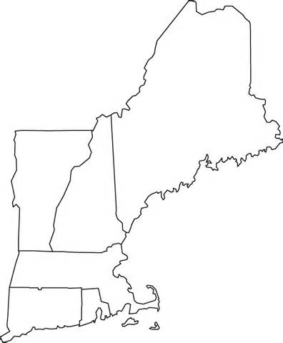
Do Now: 10/20: Fill in the map of the New England Colonies.

Slide 2
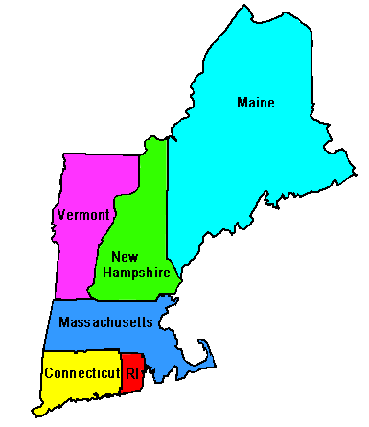
New England Colonies:

