Slide 1
Do Now: 10/26:
What is a civilization?
What do you think are the characteristics of a civilization? (Hint-there are 7!)

Slide 2
Chapter 3: Mesopotamia and the Fertile Crescent
The First Civilization

Slide 3
7 Characteristics of Civilization
Vocab | Definition | Sentence | Image
Stable Food Supply
Religion
Government
Social Structure
Humans have a constant source of food and a surplus.
Humans used religion to explain natural occurrences.
Humans organize themselves to keep order and set rules
Humans organize themselves into classes usually based on jobs.

Slide 4
Vocab | Definition | Sentence | Image
Technology
Written Language
Art
Humans will create new items that help to make their lives easier.
Humans will create writing systems to communicate, keep records, and document their history.
Humans will create different types of art to show what is important to their culture and lives.

Slide 5
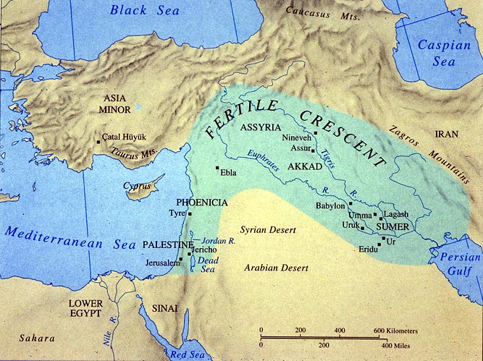
Mesopotamia
Do Now: Restate and answer each question in your notebook.
1. What region of the world is this?
What are 4 geographical features within or around the Fertile Crescent?
Why would people choose to settle in this area?

Slide 6
Mesopotamia
Part of the “Fertile Crescent”
Known as the
“Cradle of Civilization”

Slide 7
Do Now: 10/28
You are a farmer in Southwest Asia about 6,000 years ago. You live near a slow-moving river, with many shallow lakes and marshes. The river makes the land in the valley rich and fertile, so you can grow wheat and dates. But in the spring, raging floods spill over the riverbanks, destroying your fields. However, in the hot summers, you are often short of water.
How can you control the waters of the river?

Slide 8
I. The Land Between the Rivers
Mesopotamia: means “land between the rivers” in Greek
Fertile plain between Tigris and Euphrates Rivers
Part of the Fertile Crescent-large arc of fertile farmland

Slide 9
The Fertile Crescent

Slide 10
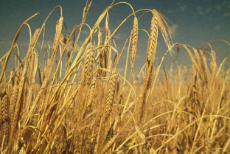
II. Rise of Civilization
Farming settlements developed in Mesopotamia around 7000B.C.
Grew wheat, barley, grains
Livestock (animals), birds, and fish
Tigris and Euphrates Rivers carried silt which enriched the land
Surplus of food
Population growth
villages
civilizations

Slide 11
Tigris River Valley

Slide 12
III. Farming and Cities
Mesopotamians were problem solvers!
Problems:
Floods
Droughts
Hot, dry climate
Not many natural resources
Solutions:
Irrigation: way of supplying water to land
Canals: man-made waterways-helped farm and trade
https://www.youtube.com/watch?v=5RP2KfewiJA

Slide 13
Do Now: 11/1
You are a crafter living in one of the cities in Sumer. Thick walls surround and protect your city, so you feel safe from the armies of other city-states. But you and your neighbors are fearful of other beings-gods and spirits that you believe are everywhere. They can bring illness, sandstorms, or bad luck.
How might you protect yourself from gods and spirits?

Slide 14
Section 2: The Rise of Sumer
Sumer= world’s 1st civilization
Most people are farmers
Cities were the center of society
City-states formed (like a country)
Sumerians city-states fought each other over power, land, and resources
Legendary king- Gilgamesh
https://www.brainpop.com/socialstudies/worldhistory/sumerians/

Slide 15
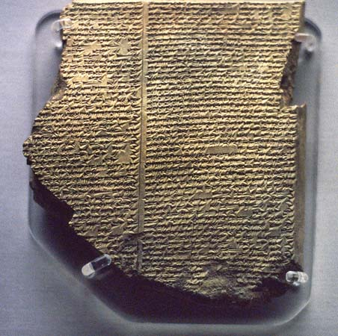
Epic of Gilgamesh
https://app.discoveryeducation.com/learn/videos/ca8d95b3-48b5-4c57-bfcd-ceddd830072b?hasLocalHost=false

Slide 16
Do Now: 11/2
Most people in Mesopotamia believed in multiple gods. If you were growing up in Mesopotamia, who would be some of the gods you would pray to? Explain why you chose those gods.

Slide 17
I. Sumerian Characteristics:
Religion:
Polytheistic: worshipped many gods
Each city-state worshipped a different main god
Believed every area of life depended on the gods!
Believed they needed to please the gods in order to live.
Priests are very important people in society

Slide 18
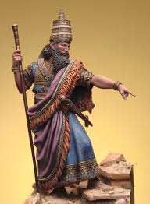
II. Social Classes:
King
Upper Class- priests, nobility, rich merchants
Lower Class- merchants, farmers, artisans
Lowest Class- slaves captured from war, or owe money

Slide 20
Section 3: Sumerian Achievements:
I. Writing:
Cuneiform: the world’s first writing system!
Started as pictographs or picture symbols
Then became symbols that stood for words or phrases
First started to keep business records
Scribe: professional writer used to keep records (way to move up the social structure!)
Later wrote works on history, law, grammar, math, and literature

Slide 21
Cuneiform

Slide 22
Clay tablet and stylus

Slide 23
Sumerian Ziggurat (Temple)
http://my.hrw.com/ss_2012/ms_whist12/eactivities/Animation/wh02_ziggurat.html

Slide 24
The Great Ziggurat at Ur

Slide 25
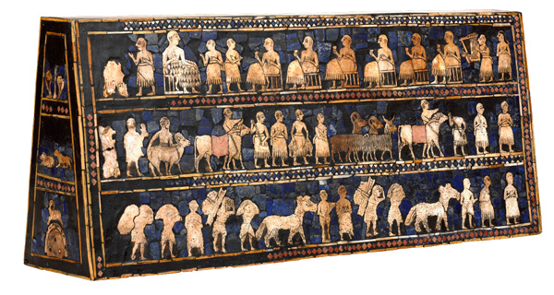
The Standard of Ur

Slide 26
