Slide 1
I. India’s Geography:
Do Now: 12/13:
Draw a picture of India.
Make a list of anything else you already know about India.

Slide 2
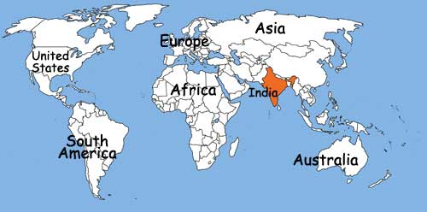
Welcome to India!

Slide 3
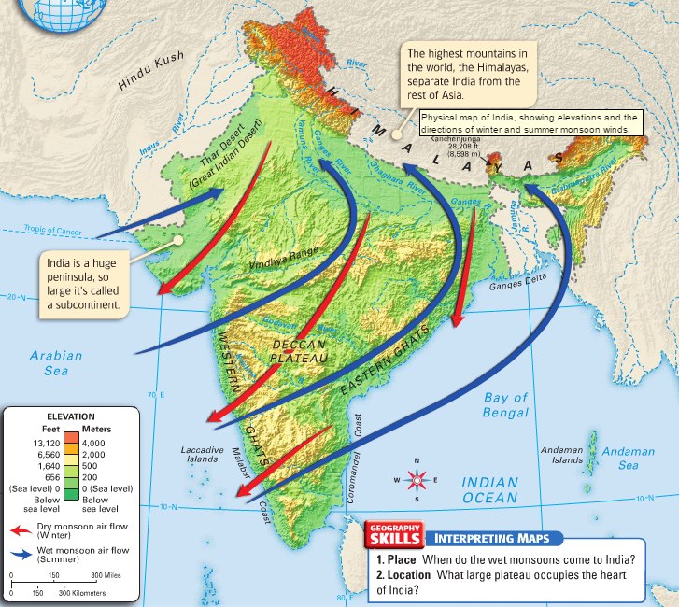
Indian Subcontinent
Called a subcontinent because the region is so large and separated by water or mountains from other land areas.

Slide 4
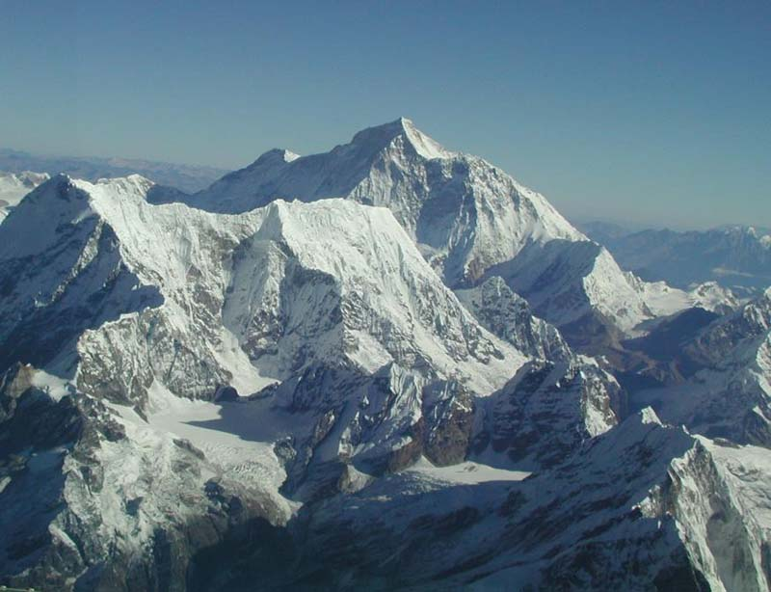
A Diamond Breaks Away
Some believe South Asia was formed when its plate broke off from a landmass and collided with Europe and Asia.
The plates also formed Mt. Everest-continues to rise.

Slide 5
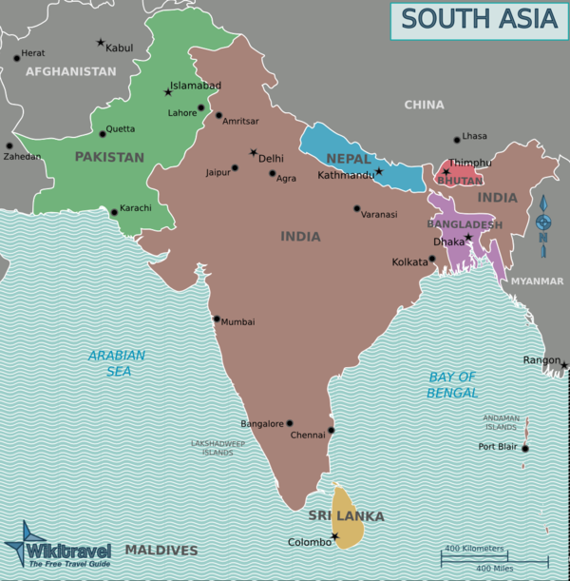
South Asian Subcontinent
*8 countries in South Asia
Afghanistan.
Bangladesh.
Bhutan.
India.
Nepal.
Maldives.
Pakistan.
Sri Lanka.

Slide 6
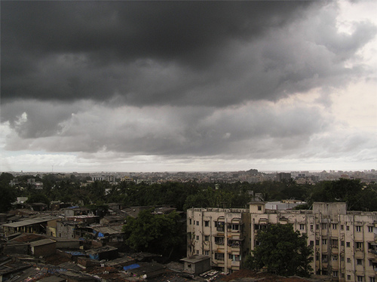
South Asia: Snow to Monsoon
Hindu Kush Mountains and Himalayas separate South Asia from rest of Asia
Many different landforms, but similar climate
**Monsoon season important to farmers- depend on rain for crops**

Slide 7
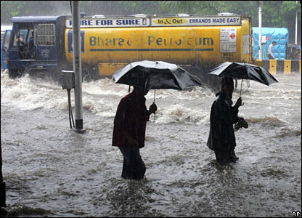
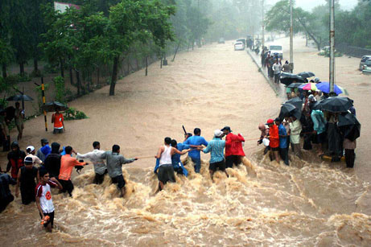
Diverse Landforms, Similar Climate
South Asian subcontinent includes: mountains, plains, deserts, rivers, dry plateaus, and islands.
3 Seasons:
  Mild (Oct.-Feb.)
  Droughts, very hot (March-May)
  monsoon or rainy season (June-Sept.)
    **Very important to farmers-refreshes soil after dry season

Slide 8
Great Rivers, Great Plain
Indo Ganges Plain:
  Located in the Northwest
  3 rivers- the Indus, the Ganges, and the Brahmaputra carry water & silt to irrigate & enrich fields on Indo-Ganges Plain
  Monsoons help spread silt
  Most people are Subsistence farmers- grow food just for your family- not to trade or sell
  Very heavily and densely populated
  Much of the population lives here
Indus River Valley:
-on a plain in Pakistan
-first civilizations in India developed here- Harappans

Slide 9
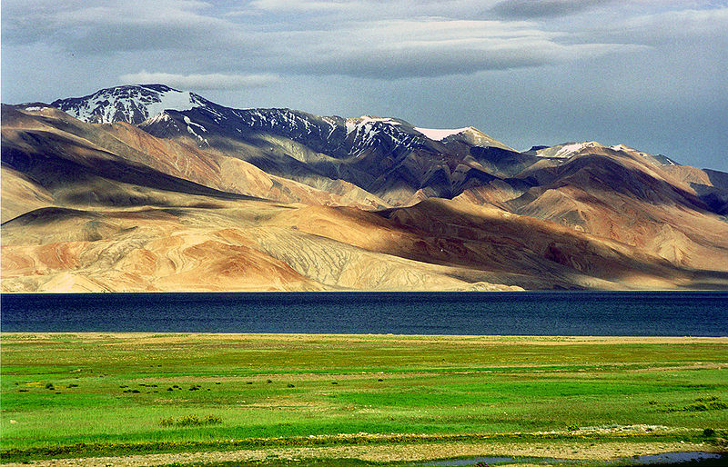
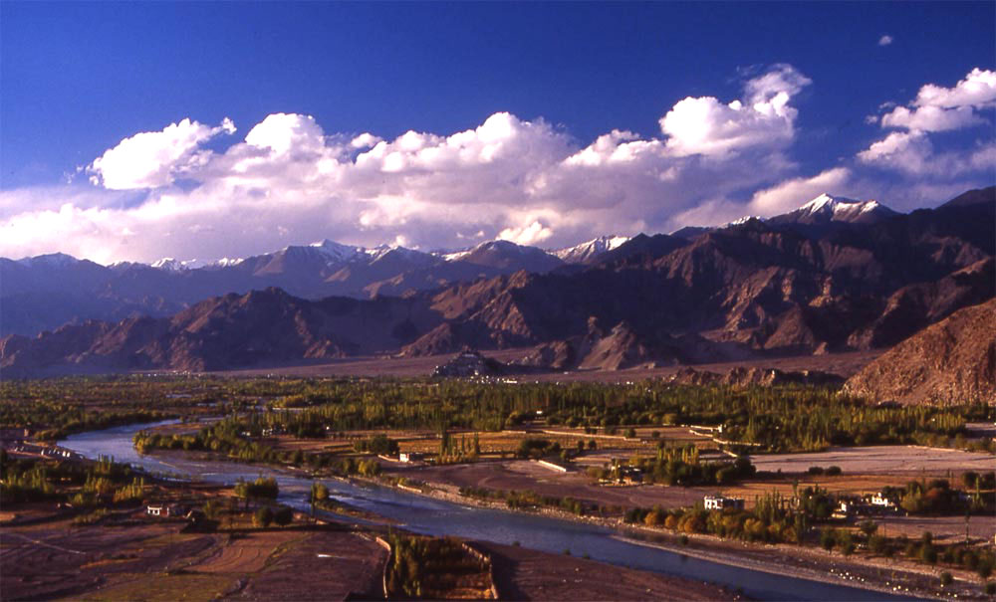
Great Rivers, Great Plain

Slide 10
Plateau, Coast, and Islands
Deccan Plateau:
  Towards the southern point of the “diamond”
  Dry climate-more irrigation needed
  Rich, volcanic soil
  Cotton and peanuts-main crops
  Surrounded by mountains-Western Ghats and Eastern Ghats
Coasts and Islands:
  Many people fish and farm- India is a peninsula
  Sri Lanka and Maldives-island nations, make a lot of clothing

Slide 11
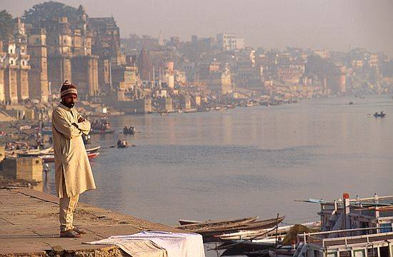
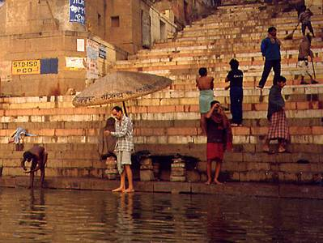
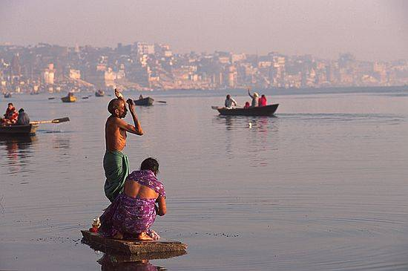
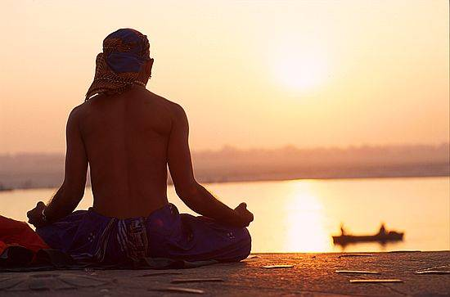
“Mata Ganga” (Mother Ganges)

Slide 12
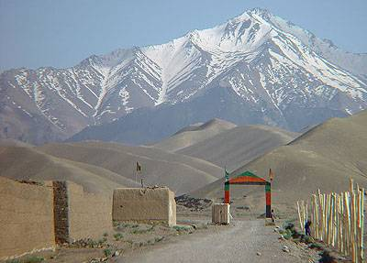
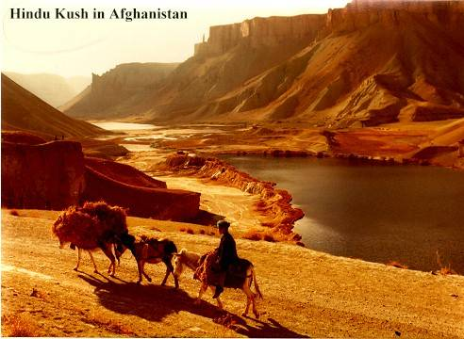
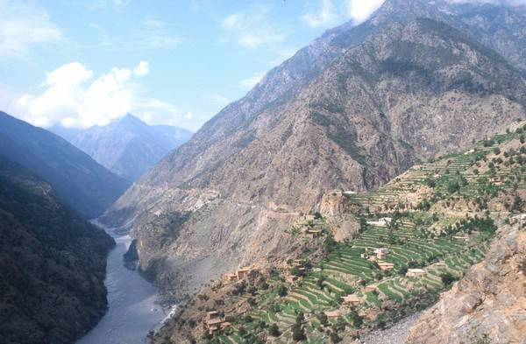
Hindu Kush

Slide 13
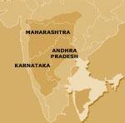
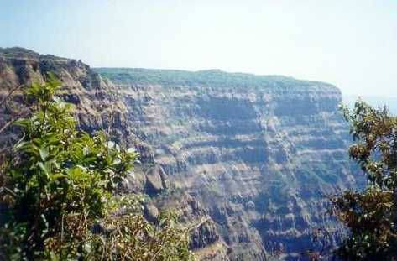
The Deccan Plateau

Slide 14
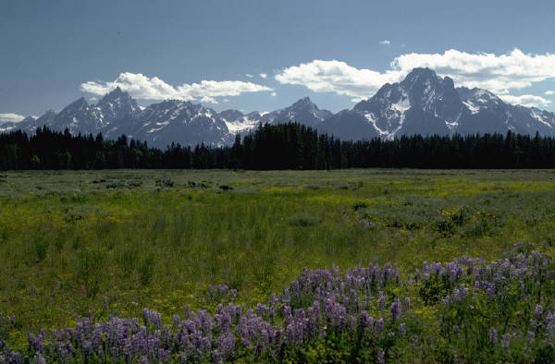
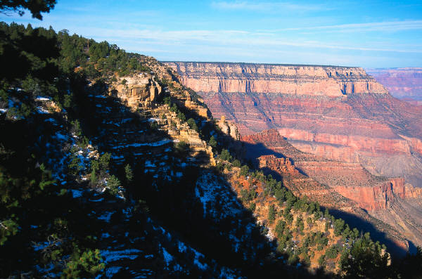
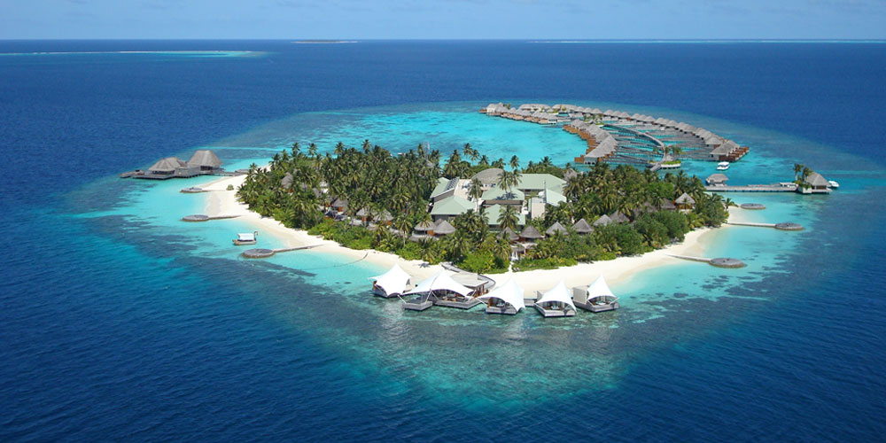
Plateau, Coast, and Islands

Slide 15
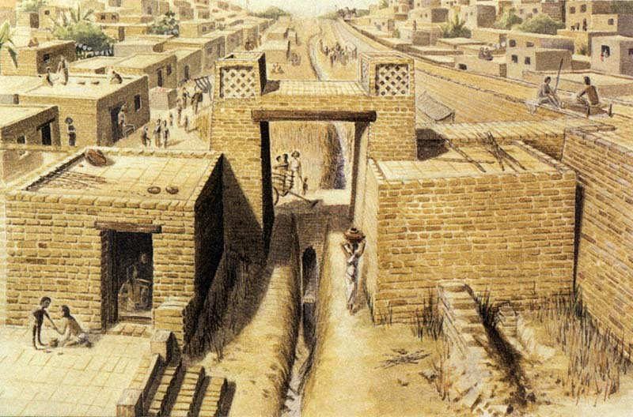
The Ancient Harappans

Slide 16
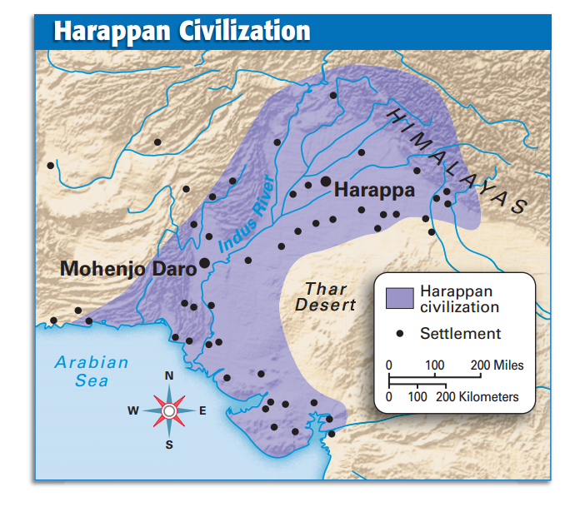
The Harappan Civilization

