Slide 1
Do Now:
Why might both the Egyptians and Greeks developed myths?
What type of religion, did the Ancient Greeks practice?
Name Homer’s two most famous books?

Slide 2
Greek Artistic Traditions
The human figure is idealized
The figure is portrayed in action poses
Architecture reflects the ideal of perfect proportion creating a sense of balance and harmony
Columns are an integral part of architectural design

Slide 3
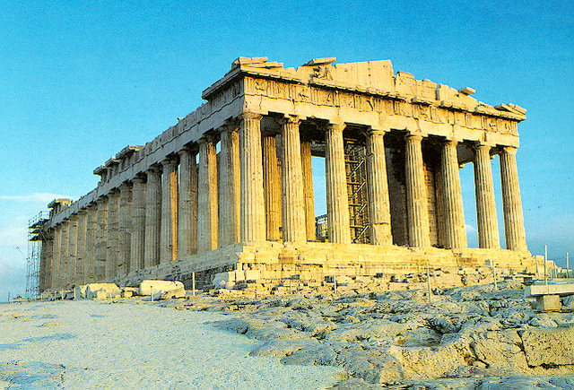
Greek Architecture

Slide 4
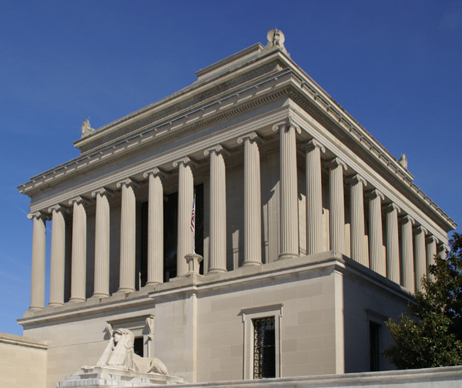
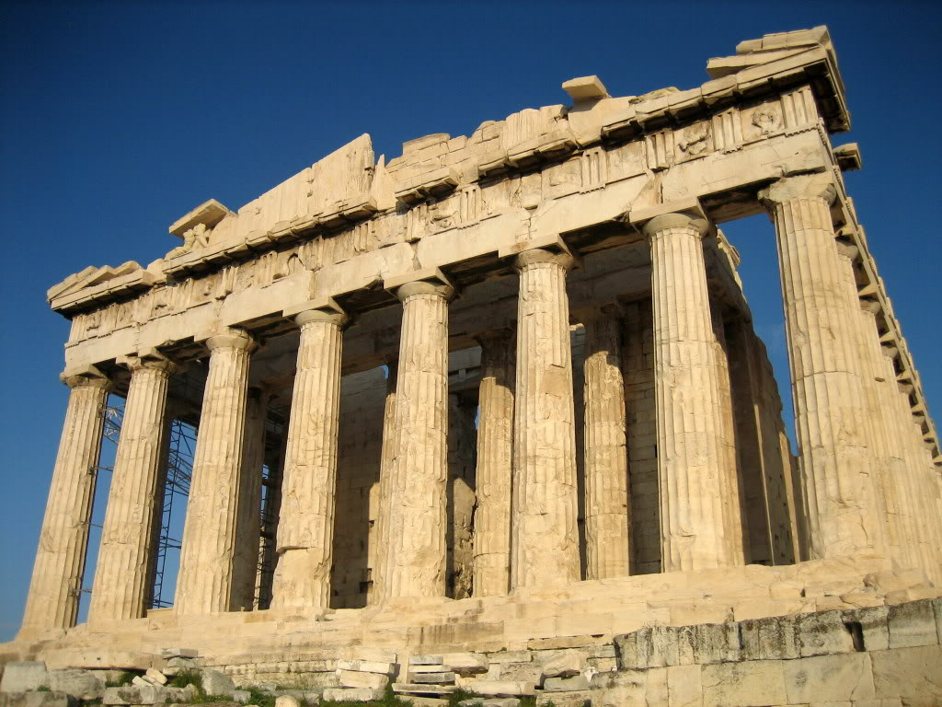
One of the many accomplishments of the ancient Greeks is their art and architecture. Public buildings were decorated with carvings of animals, people’s faces, leaves and flowers. Every element of a building was a work of art.
Classical Architecture.

Slide 5
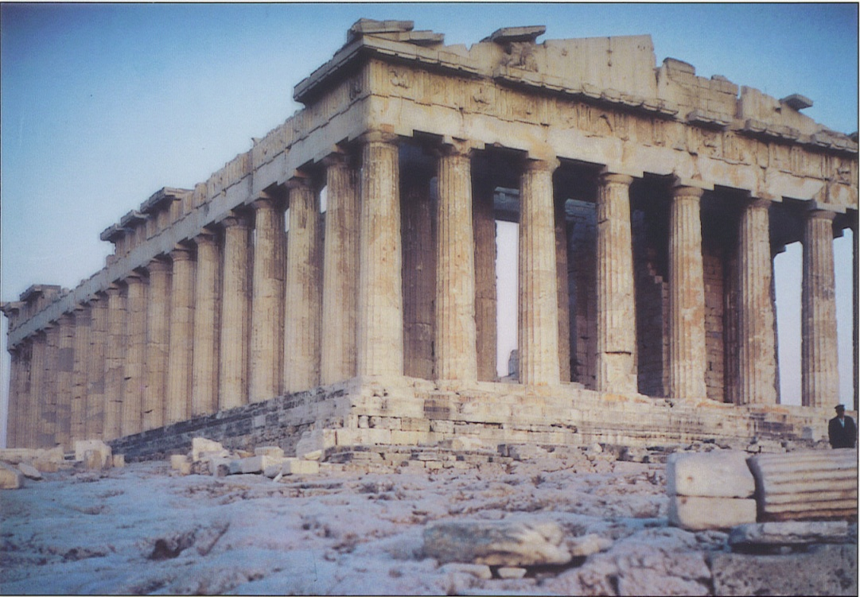
Greek life was dominated by religion, so it is not surprising that their temples were the biggest and most beautiful buildings. The temples also had a political purpose, as they were often constructed to show civil pride and power or to offer thanks to a patron god or goddess of the city-state for success in war. The temples were made of limestone or marble, with a roof or ceiling made of wood. The builders made use of stone columns.

Slide 6
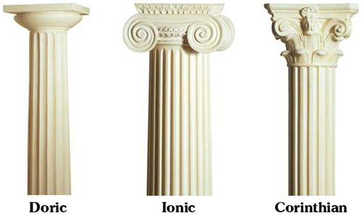
Types of Columns:
There are three different types of columns: Doric, Ionic, and Corinthian.

Slide 7
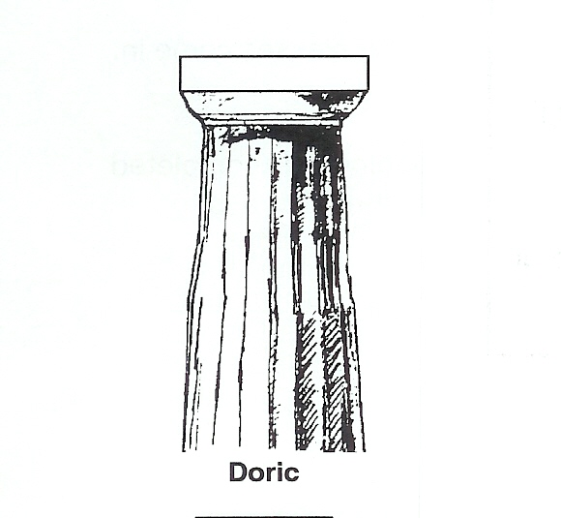
Doric Columns
The Doric style was simple. The columns were either grooved or fluted and had a plain top (capital). The column did not have a base, it stood flat on the floor.

Slide 8
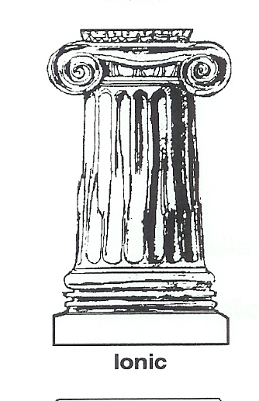
Ionic Columns
The Ionic columns were more delicate and decorative. The columns were taller and slimmer. They were also fluted, but had a flattened rib between each flute. The columns rested on a decorative base (plinth). The capital was carved into a fluted shape.

Slide 9
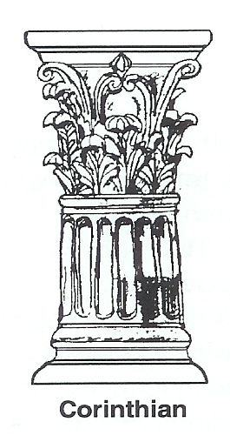
Corinthian Columns
The Corinthian columns were still more decorative and delicate. The columns were also fluted and had a flattened rib between each flute. The capital of this column has carved leaves and vines. It appeared approximately 5th century B.C.E.

Slide 10

Examples of these types of columns can be found in buildings today all throughout the world. The New York Stock Exchange in Manhattan has Corinthian columns.

Slide 11
It’s Quiz Time!

Slide 12
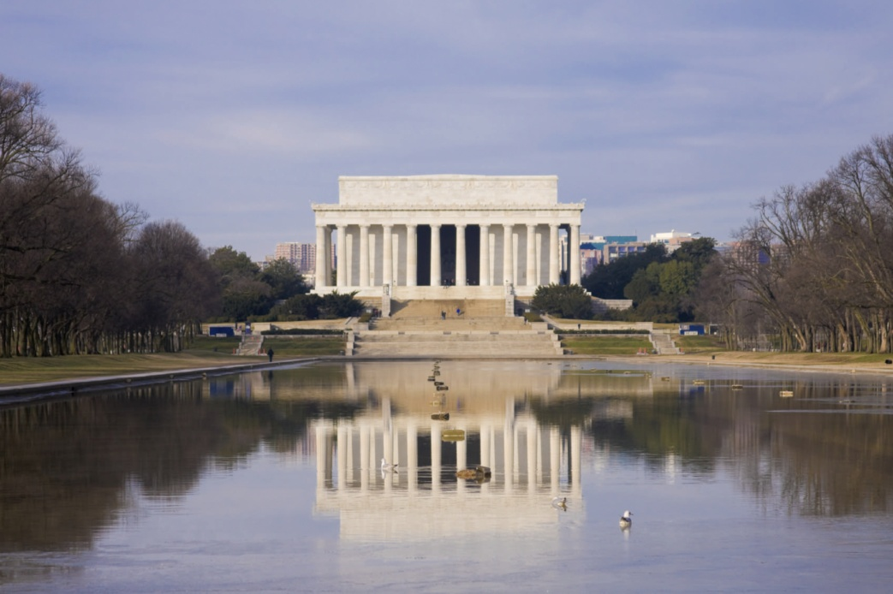
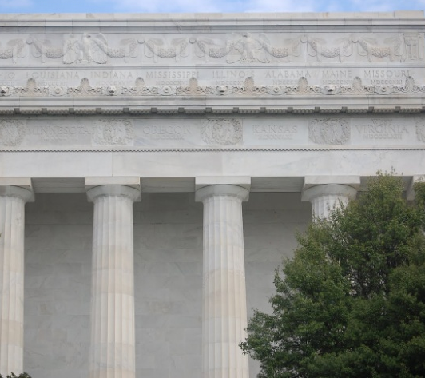
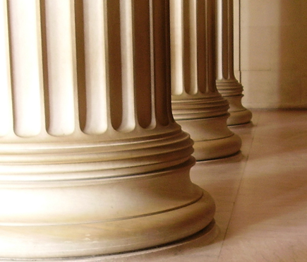
Can you guess what type of columns are used on this building, the Lincoln Memorial?
Answer: Doric columns

Slide 13
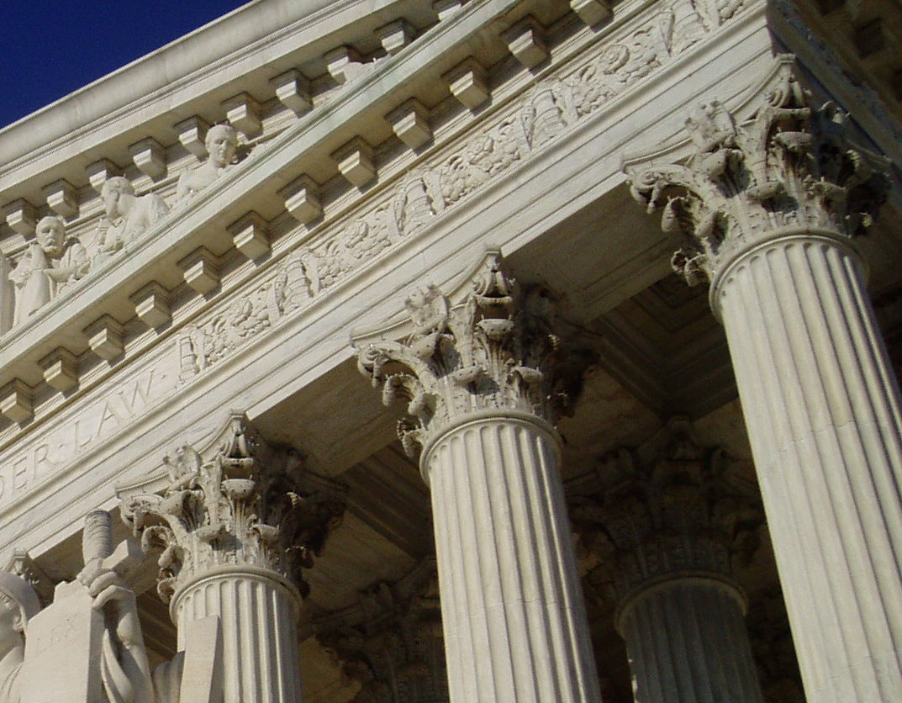
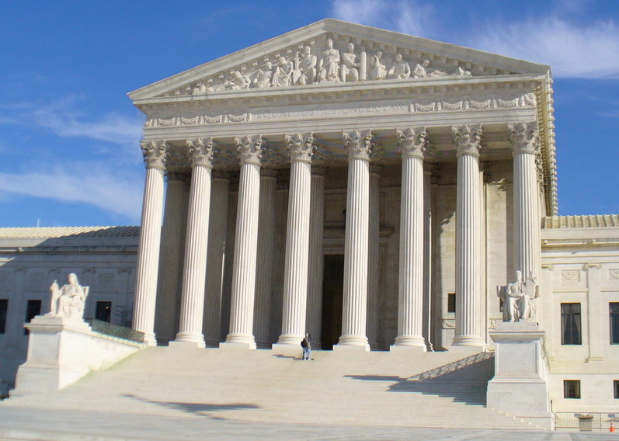
Can you guess which type of columns are used on this building, the Supreme Court?
Answer: Corinthian columns

Slide 14
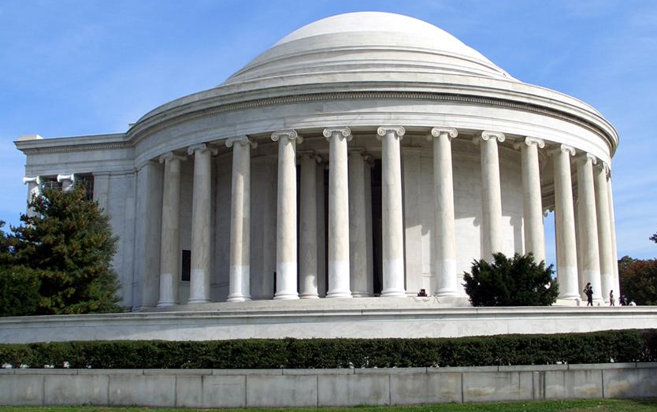
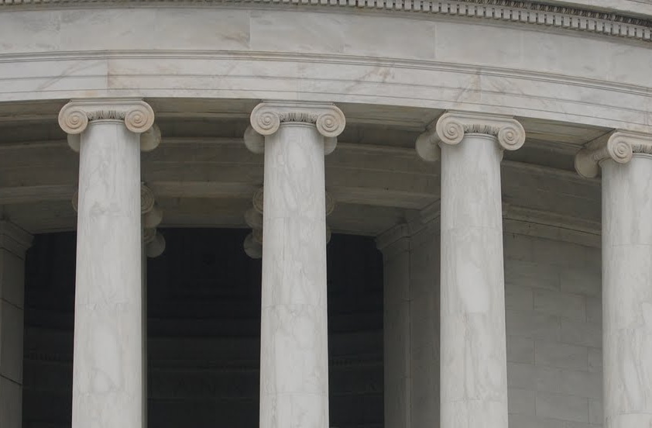
Can you guess which type of columns are used on this building, the Jefferson Memorial?
Answer: Ionic columns

Slide 15
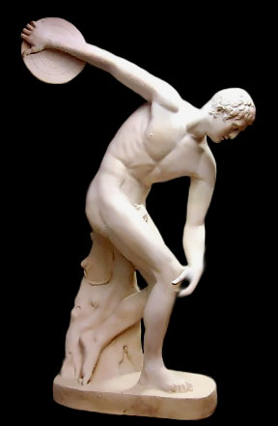
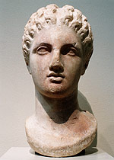
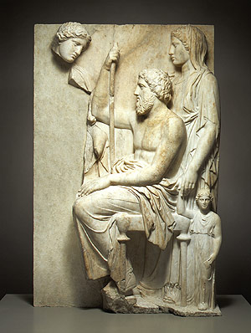
CLASSICAL ART
480-323 BC

Slide 16
CLASSICAL ART
Background:
  After Persian Wars (480 BC), Greece experienced a Golden Age.
  Athens held special position. Became very powerful.
  Golden Age was centered in Athens.
  A Golden Age is an explosion of creativity in art, science, etc.
  This is the period when Classical Art and Architecture was born.

Slide 17
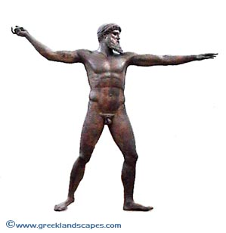
CLASSICAL ART
Zeus of Artemesium (460-450 BC)
6’10.5” high. Rescued from 140 ft depth in water.
The Classical period of Ancient Greece produced some of the most exquisite sculptures the world has ever seen.
Characterized by a joyous freedom of movement, freedom of expression.
The human figure was expressed in a more naturalistic manner

Slide 18
CLASSICAL ART
The greatest name in Greek sculpture was Phidias.
Built the Parthenon and statues of gods.
He initiated the Classical style of art.
After the Persian Wars, Athens was destroyed.
Pericles. Leader of Athens, got the city to undertake a massive building program.
  He appointed Phidias artistic director.

Slide 19
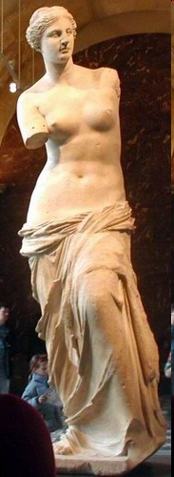
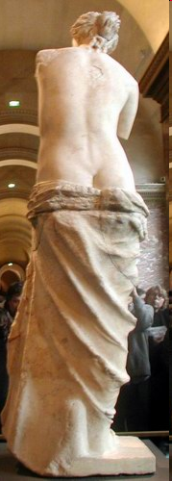
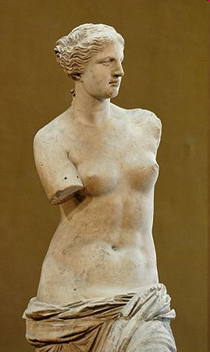
Venus de Milo
Aphrodite of Milos, better known as the Venus de Milo, ancient Greek statue and one of the most famous works of ancient Greek sculpture. some time between 130 and 100 BC, the Hellenistic period (323–31 BC) , it is believed to depict Aphrodite (Venus to the Romans) the Greek goddess of love and beauty.

Slide 20
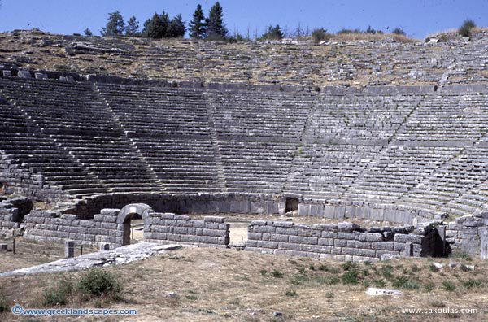
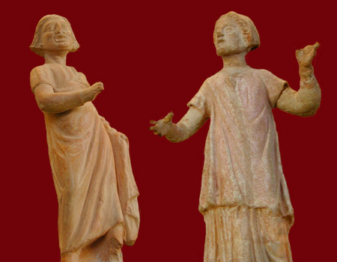
Theater
Theater in every major Greek city
First theatrical productions - Athens Dionysus festival 500 BC
  Initially a single actor accompanied by a chorus of singers
  All wore masks – allowed actors to play multiple roles
  All male cast – played female roles
Plays sponsored by wealthy patrons

Slide 21
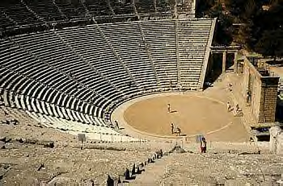
Greeks design the Amphitheater

Slide 22
