Slide 1
Alexander The Great

Slide 2
Macedonia

Slide 3
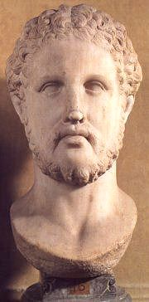
Phillip II of Macedon
Ruled Macedonia from 359-336 B.C. and transformed it into a powerful military machine
By 338 he had Greece under his control

Slide 4
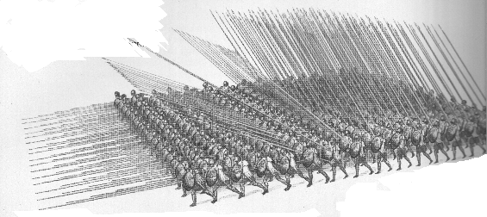
The Phalanx
Used as a brute-force breakthrough formation. Philip made the Phalanx a versatile weapon, with the ability to advance, hold and retreat in good order.
It was primarily used as a holding force while the Companion cavalry delivered the main blow against the enemy.

Slide 5
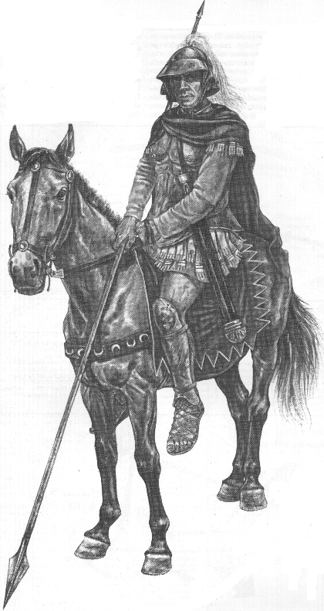
Companion Calvary

Slide 6
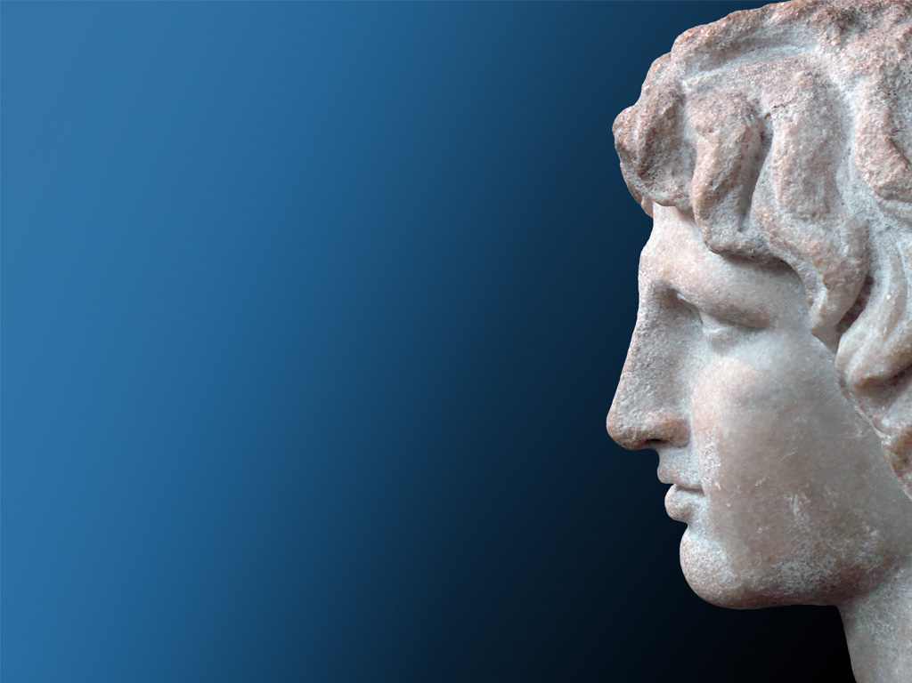
Alexander the Great
Phillip II is assassinated in
336 BCE
Alexander is crowned king
Phillip had prepared Alexander
well for kingship
Military Experience
Tutors

Slide 7
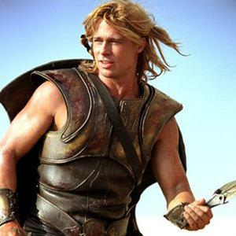
Alexander the Great
Heavily influenced by Greek culture
Student of Aristole
Inspired by the stories of Achilles and Hercules.
Kept a dagger and a copy of the Iliad under his pillow.

Slide 8
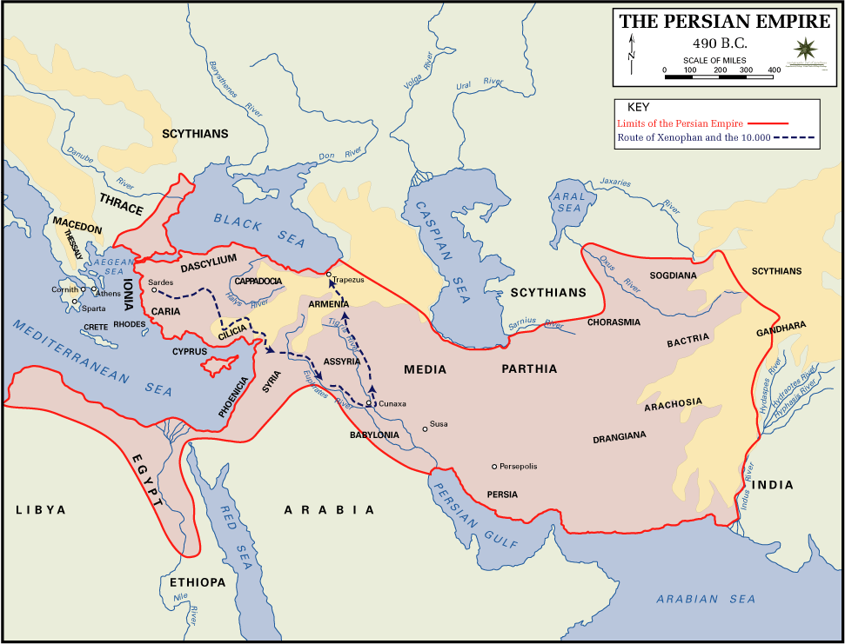
Alexander’s Vision

Slide 9
The Conquest Begins– 334 BCE
His army totaled 37,000 Greek and Macedonian men. 5,000 of which were cavalry.
Darius III, king of Persia, called forth a massive multinational army to meet the invaders. Estimates range from 200,000 to one million soldiers

Slide 10
The Conquests of Alexander
Conquests | Dates
Freed Ionian Greek cities | 333 BCE
Palestine, Syria, & Egypt | 332 BCE
The Battle of Gaugamela | 331 BCE
Heavily outnumbered, Alexander crushes the Persians at the Battle of Issus.
Alexander establishes Alexandria as the Greek capitol of Egypt!
Near Babylon, Alexander decisively defeats Darius! Becomes the ruler of the entire Persian Empire!
1
2
3
Alexander was still not satisfied!

Slide 11
The Conquests of Alexander
For the next three years, Alexander moves east and northeast.
Afghanistan & Pakistan
In 326 BCE, Alexander moves into India.
Series of a hard fought campaigns
Macedonians refuse to go any farther
Alexander’s army returned to Babylon, where he dies in June 323 BCE of wounds, fever, and too much alcohol.

Slide 12
Why was Alexander so successful??
Great Military Leader
Master of strategy and tactics
He was fearless
Led his men into battle
While in India, Alexander was the first to leap over a city wall in order to inspire his troops.

Slide 13
Example of a Timeline
356 BC Alexander the Great is born.
336 BC
Death of King Phillip and Crowning of Alexander the Great as ruler of Macedonia
332 BC
The Siege of Tyre
326 BC
Battle of River Hydaspes
324 BC
Troops mutiny at Opis
323 B.C
356 B.C
338 BC
Battle of Chaeronea
334 BC
Battle of the Granicus River
331 BC
Foundation of Alexandria and Battle of Gaugamela
327 BC
Marriage to Roxane and the Beginning of the Indian Quest
323 BC The Death of Alexander the Great
Alexander The Great

Slide 14
Alexander’s Legacy
The Marriage of East & West
Alexander the Great ushered in the Hellenistic Age – A period where Greek influence could be found throughout the known world!

Slide 15
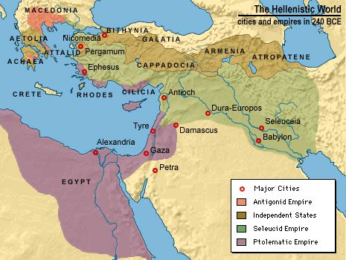
Hellenism
Hellenism
Hellenistic Culture: blending of Egyptian, Persian, Greek and Indian influences
Would forever transform Greece and Asia

